Slide 1
————[ FY24 CO-OP OFFERINGS ]————

Slide 2
Thank you to all of our FY23 Co-Op partners

Slide 3
Menu of FY24 offerings
Category | Co-Op Offering | FY24 Pricing
Research | Arrivalist Visitation Dashboard | $5,000 (for 12 months of access)
Social | Pinterest Featured Board Or Add 10 pins to existing Featured Board from a prior year | $1,000 per board Updating: $100 per batch of 10 pins
 | Programmatic Social Stories | Minimum $500 per month*
 | AARP Facebook Ads | Two monthly tiers: $5K or $15K
Digital | Texas Data Warehouse | Minimum $500 per month*
 | Mobile Speed Targeting | Minimum $500 per month*
 | Mobile Cost per Click (CPC) Ads | Minimum $500 per month*
 | AARP Digital Ads | Three tiers: $3.5K, $5K, $10K
Audio | Pandora Streaming Audio Products | $1,000 per product
Video | Online Video (OLV) | Minimum $2,000 per month*
 | Connected TV (CTV) | Three monthly tiers: $1K, $2.5K, $5K
Content | CultureMap Custom Article | $7,250
 | Expedia Custom Landing Page | Two monthly tiers: $3K or $8K
Email | Featured Placement in Travel Texas monthly newsletter | $500 per placement
Trip Builder | NEW: Travel Texas Trip Builder Inclusion | $500 (for a 5 month flight)
Partners will be responsible for supplying all necessary creative to spec. All partner creative will click out to your specified landing page.
*Partners can choose to spend more per month. No minimum number of months required.

Slide 4
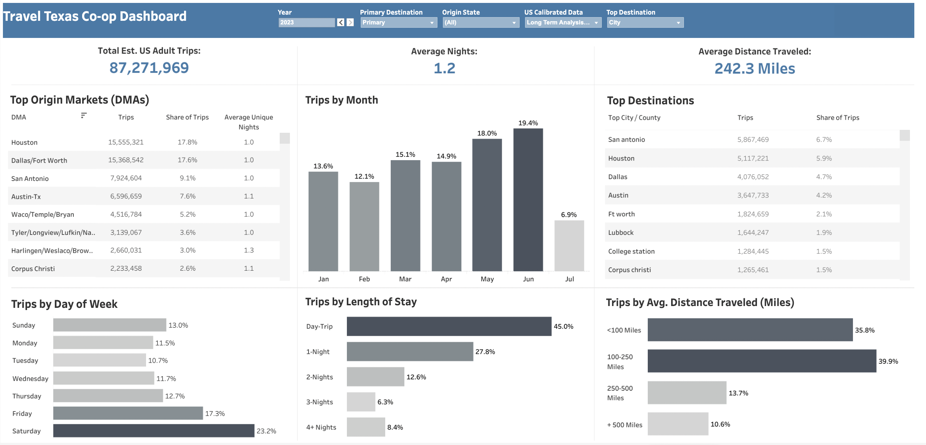
MAIN MENU
Research: Arrivalist Texas Visitation Dashboard
DETAILS: Visitation Dashboard from Arrivalist with information at the county and city levels. (Access origin markets, seasonality, length of stay information for your city or county as well as neighboring and competitive cities/counties in the state).
COST: $5,000 per year (12 months begins based on sign up. Login provided once payment is received)
AVAILABILITY: Unlimited
*Only available to DMOs with an annual marketing budget of $500K or less

Slide 5
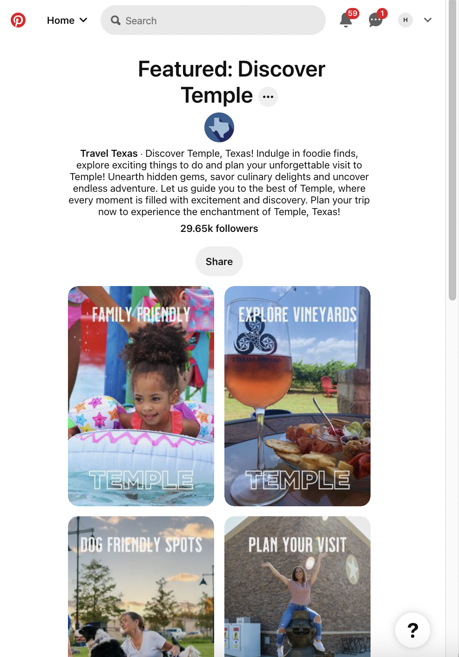
MAIN MENU
Social: Pinterest new board or update existing board
DETAILS: New Featured Board or update an existing Featured Board to inspire our 444K Pinterest followers
COST:
New Board: $1,000
Add 10 Pins: $100
AVAILABILITY: Unlimited

Slide 6
MAIN MENU
Social: Pinterest new board or update existing board (cont.)
CREATIVE REQUIREMENTS:
10X images or videos
Description for each pin
Board description
Click through URL
Signed image release
LAUNCH LEAD TIME: Creative materials due 4 weeks prior to start date

Slide 7
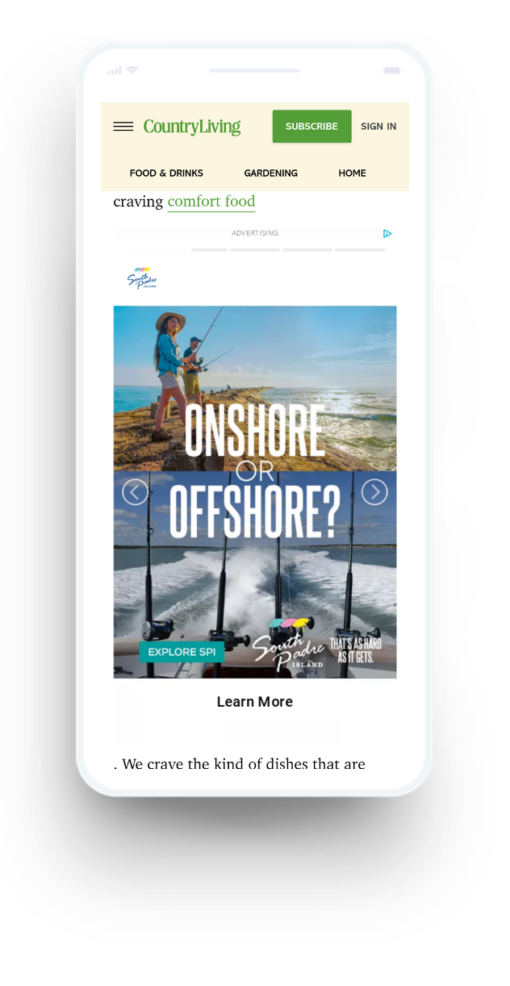
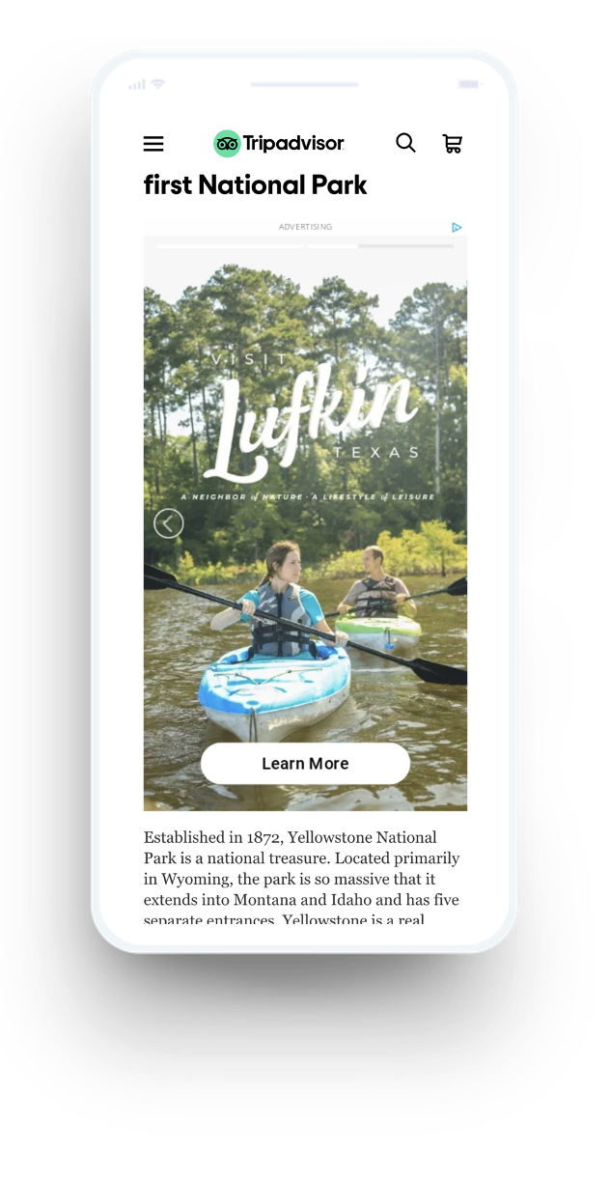
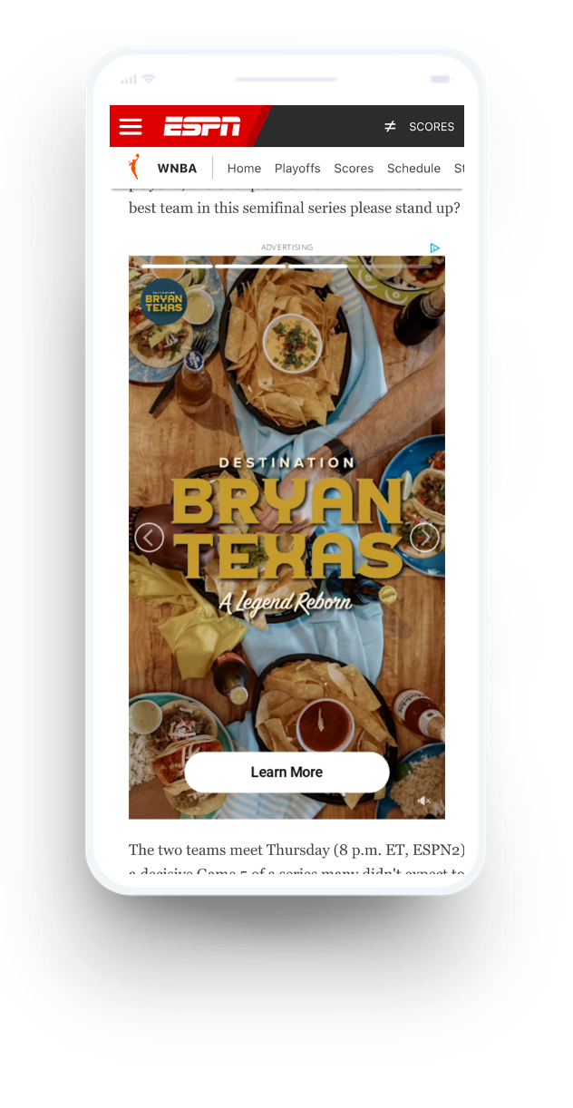
MAIN MENU
Social: Programmatic social stories
DETAILS: Leverage vertical story assets outside of social media walled gardens
COST: $500 minimum per month per format but can spend more (No minimum number of months)
AVAILABILITY: Unlimited

Slide 8
MAIN MENU
Social: Programmatic social stories (Cont.)
DISPLAY CREATIVE REQUIREMENTS: Leverage vertical story assets outside of social media walled gardens
VIDEO CREATIVE REQUIREMENTS: $500 minimum per month per format but can spend more (No minimum number of months)
LAUNCH LEAD TIME: Creative materials due 4 weeks prior to start date

Slide 9
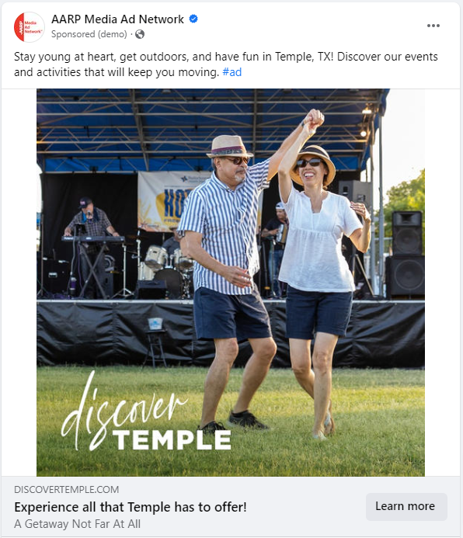
MAIN MENU
Social: AARP Facebook packages
DETAILS: AARP reaches over 53MM identified member devices on Facebook. All impressions run on Facebook
COST:
Small Package: $5,000 (192K Impressions)
Large Package: $15,000 (384K Impressions)
AVAILABILITY: Unlimited
Flight timing is flexible. No minimum number of months

Slide 10
MAIN MENU
Social: AARP Facebook packages (cont.)
CREATIVE REQUIREMENTS:
Image or video
Text
CTR
Click through URL
Maximum of 2 versions
LAUNCH LEAD TIME: Creative materials due 4 weeks prior to start date

Slide 11
MAIN MENU
Digital: AARP.org packages
DETAILS: AARP.org is the digital gateway to travelers 40+ (includes GenX and Boomers)
COST:
Small Package: $3,500 over a maximum of two months (318K Impressions)
Medium Package: $5,000 can be spread over your choice of months (454K Impressions)
Large Package: $10,000 can be spread over your choice of months (909K Impressions)

Slide 12
MAIN MENU
Digital: AARP.org packages (cont.)
AVAILABILITY: Unlimited
CREATIVE REQUIREMENTS:
300x250
300x600
Click through URL
Maximum 3 creatives
LAUNCH LEAD TIME: Creative materials due 4 weeks prior to start date

Slide 13
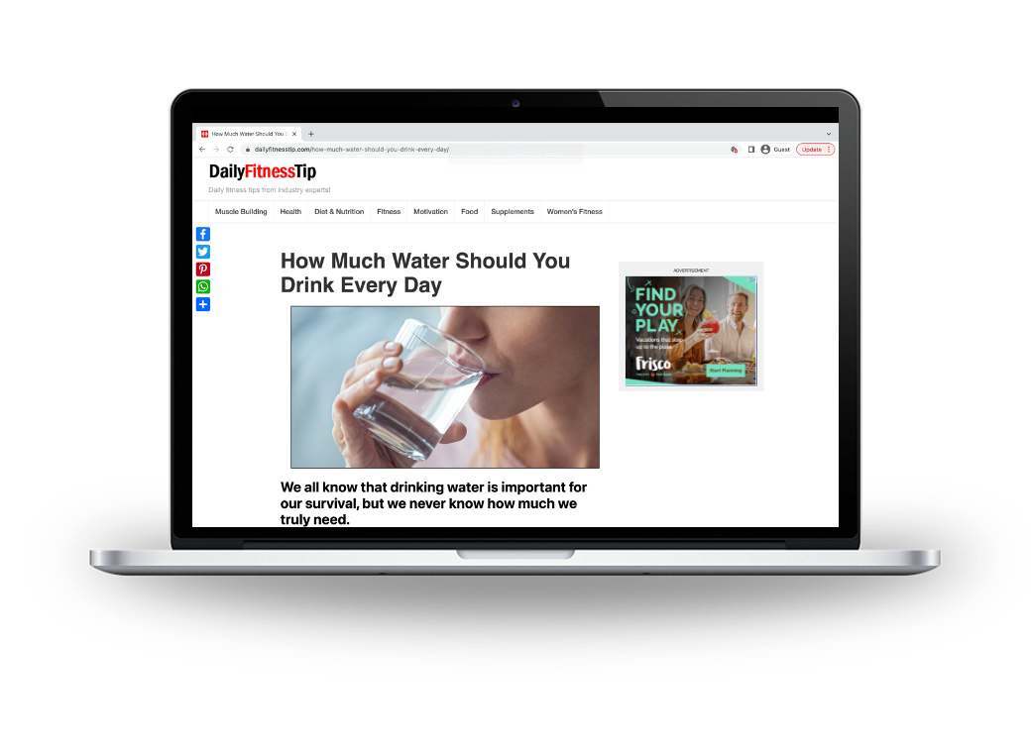
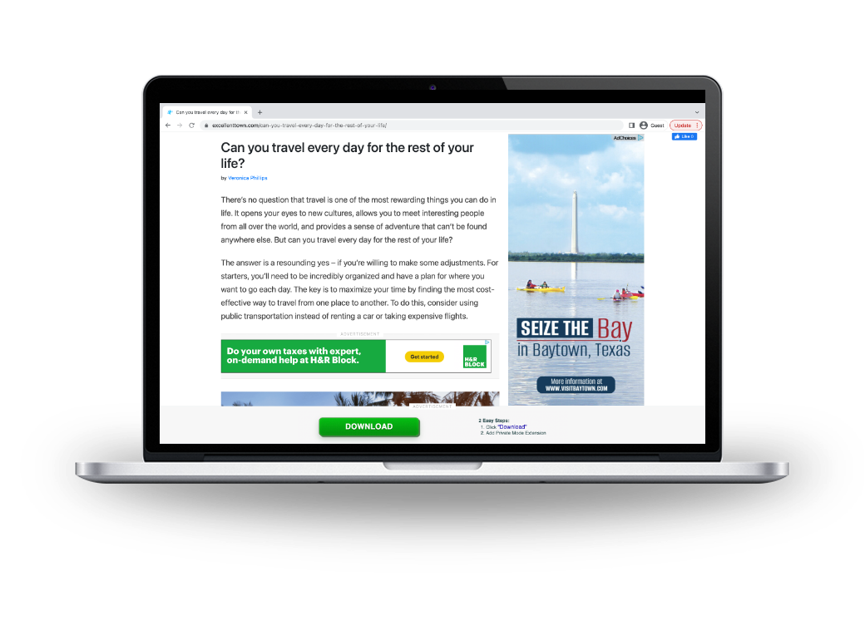
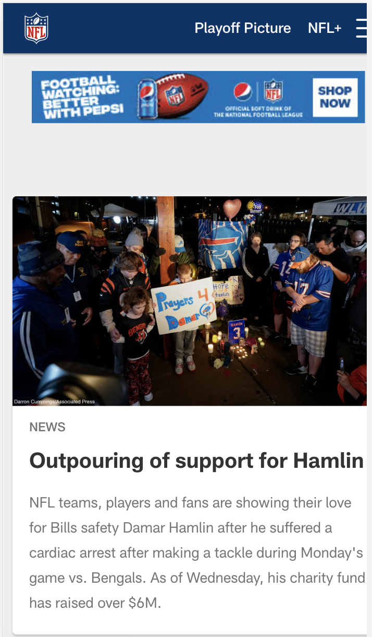
MAIN MENU
Digital: Texas Data Warehouse
DETAILS: Custom retargeting program based off visitors to TravelTexas.com and our paid media buy
COST: $500/month minimum (No minimum number of months)
AVAILABILITY: Unlimited

Slide 14
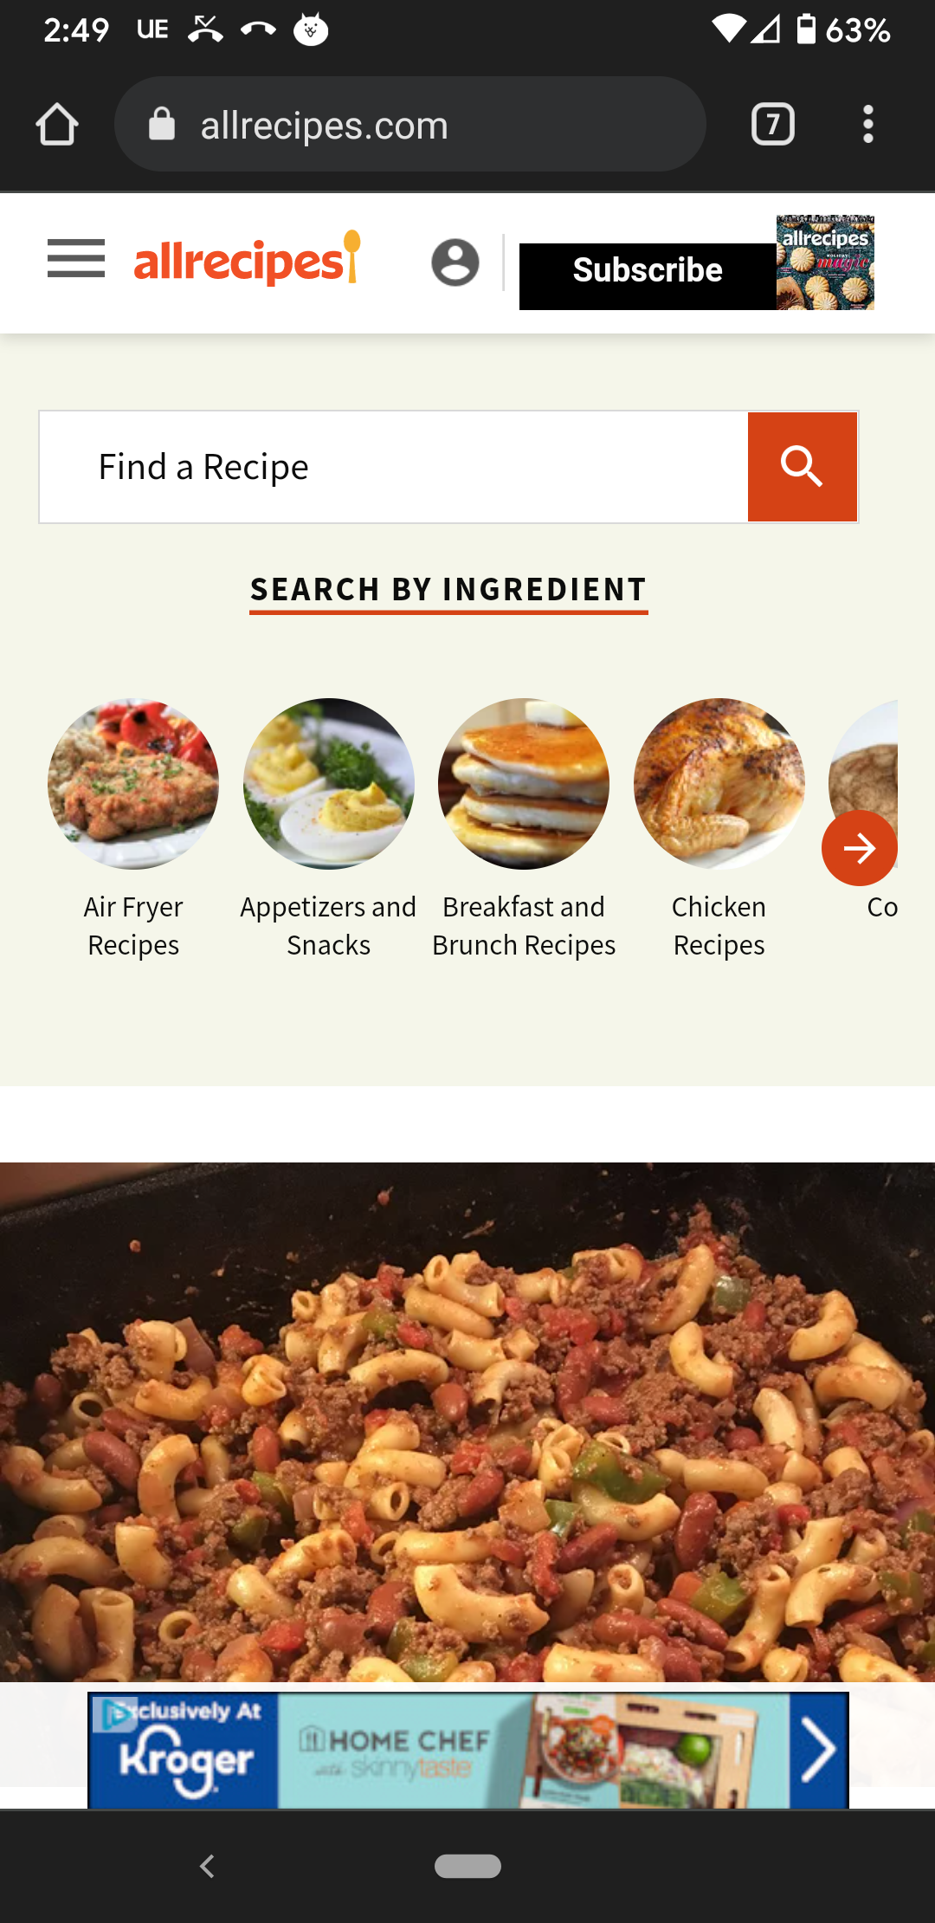
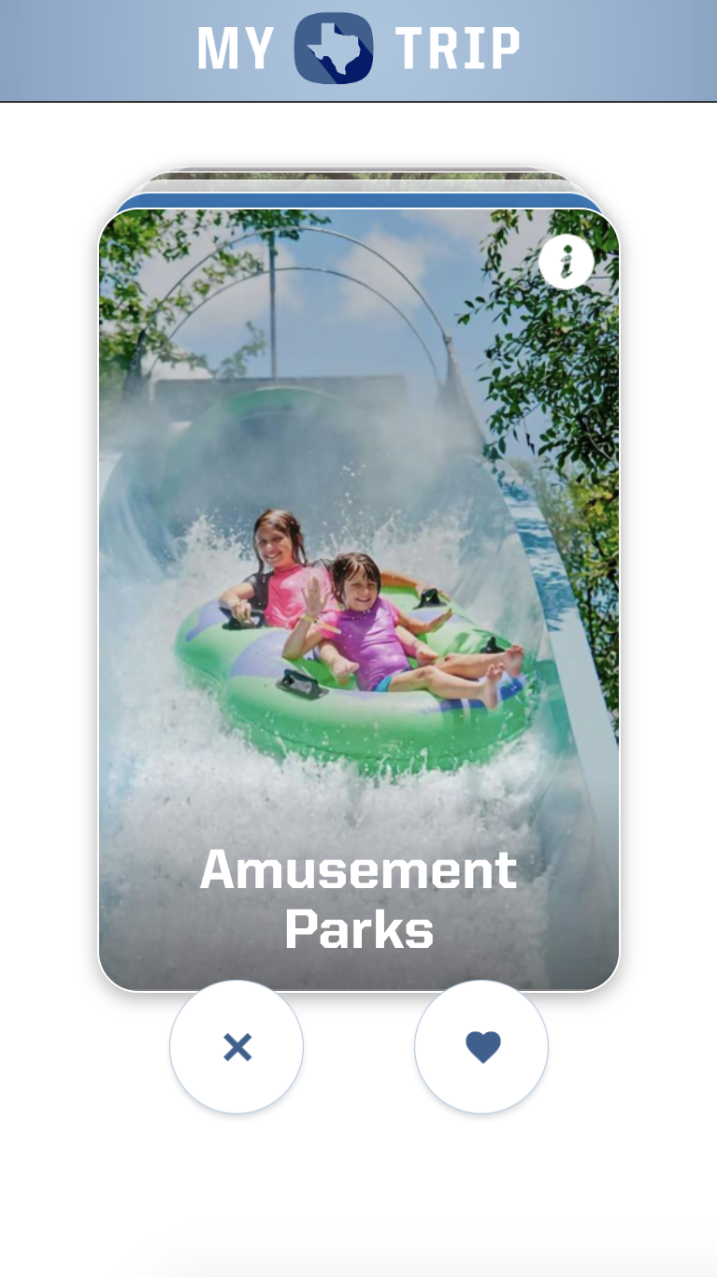
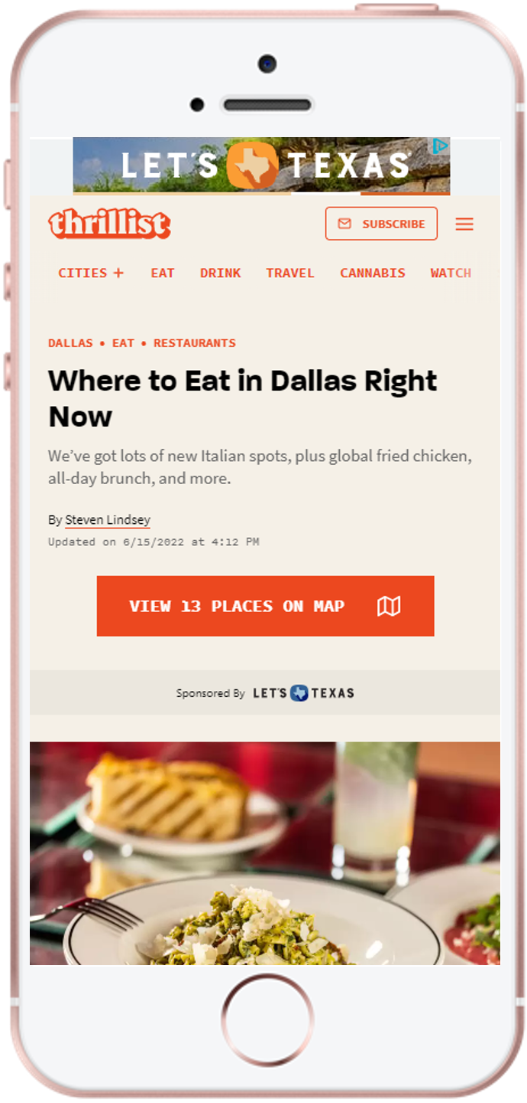
MAIN MENU
What is our Texas Data Warehouse?
Targeting is based on impression pixels from Travel Texas’s paid media buy along with retargeting pixels placed on Travel Texas
Millennial Target Demographic
Visit website and engage with Trip Builder
Watched video through Discovery
served banner on Thrillist

Slide 15
MAIN MENU
Digital: Texas Data Warehouse (cont.)
CREATIVE REQUIREMENTS:
Ad Sizes: 160x600, 300x250, 300x600, 728x90, 320x50
Click through URL
Minimum 3 ad sizes
Maximum of 3 versions
LAUNCH LEAD TIME: Creative materials due 4 weeks prior to start date
*0.40% CTR Benchmark

Slide 16
Data Warehouse targeting options
MAIN MENU
Thematic Segments | Target Demographics | Geotargeting Options (US Only)
Arts Beach Birding Family Food Golf Historic Music Outdoor Shopping | MILLENNIALS (A20-34, HHI $40K+) | State DMA Flexible to accommodate Co-Op partners request
 | GENX (A35-49, HHI $60K+ with kids in HH under 18)
 | BOOMERS (A50+, HHI $60K+)
Available impressions will predominately be outside of Texas to align with the state’s paid media efforts.
In-state availability will be case by case.

Slide 17
MAIN MENU
Digital: Texas Data Warehouse
AVAILABILITY | CREATIVE REQUIREMENTS | LAUNCH LEAD-TIME
No cap on the number of partners that can sign up | 160x600, 300x250, 300x600, 728x90, 320x50 Click through URL Minimum 3 ad sizes Maximum of 3 versions | Creative materials due 4 weeks prior to start date

Slide 18
MAIN MENU
Digital: Mobile speed targeting
DETAILS: Mobile ads are triggered based on user’s travel patterns of speed, distance, and hotel stop(s) showing they are roadtrippers
COST: $500/month minimum (No minimum number of months)
AVAILABILITY: Unlimited
For example purposes only

Slide 19
MAIN MENU
Digital: Mobile speed targeting
CREATIVE REQUIREMENTS:
Ad Sizes: 320x50
Click through URL
Maximum of 3 versions
LAUNCH LEAD TIME: Creative materials due 4 weeks prior to start date
For example purposes only
*0.07% CTR Benchmark

Slide 20
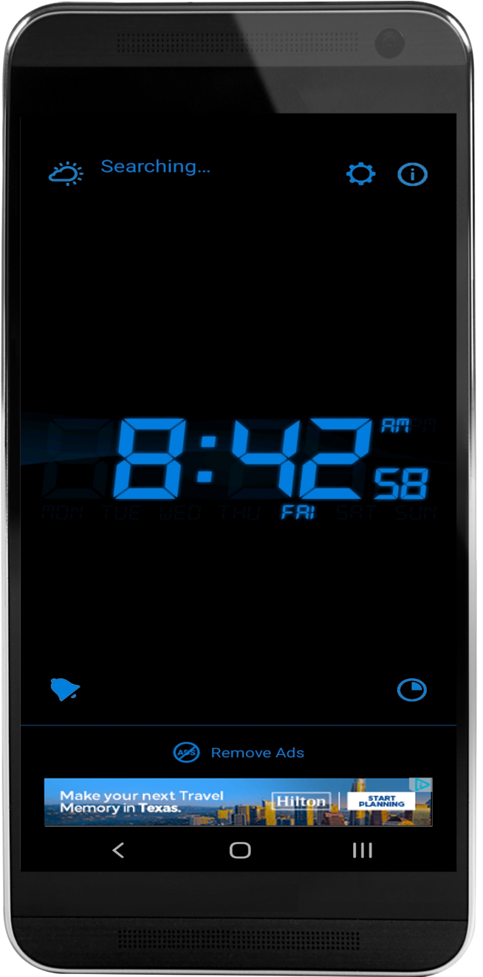
MAIN MENU
Digital: Mobile cost per click (CPC) ads
DETAILS: Media focused on driving clicks and traffic to your website through set CPC mobile display buy
COST: $500/month minimum (No minimum number of months)
AVAILABILITY: Unlimited

Slide 21
MAIN MENU
Digital: Mobile cost per click (CPC) ads
CREATIVE REQUIREMENTS:
Ad Sizes: 320x50, 300x250, 320x480
Click through URL
Maximum of 3 versions
LAUNCH LEAD TIME: Creative materials due 4 weeks prior to start date
*0.30% CTR Benchmark

Slide 22
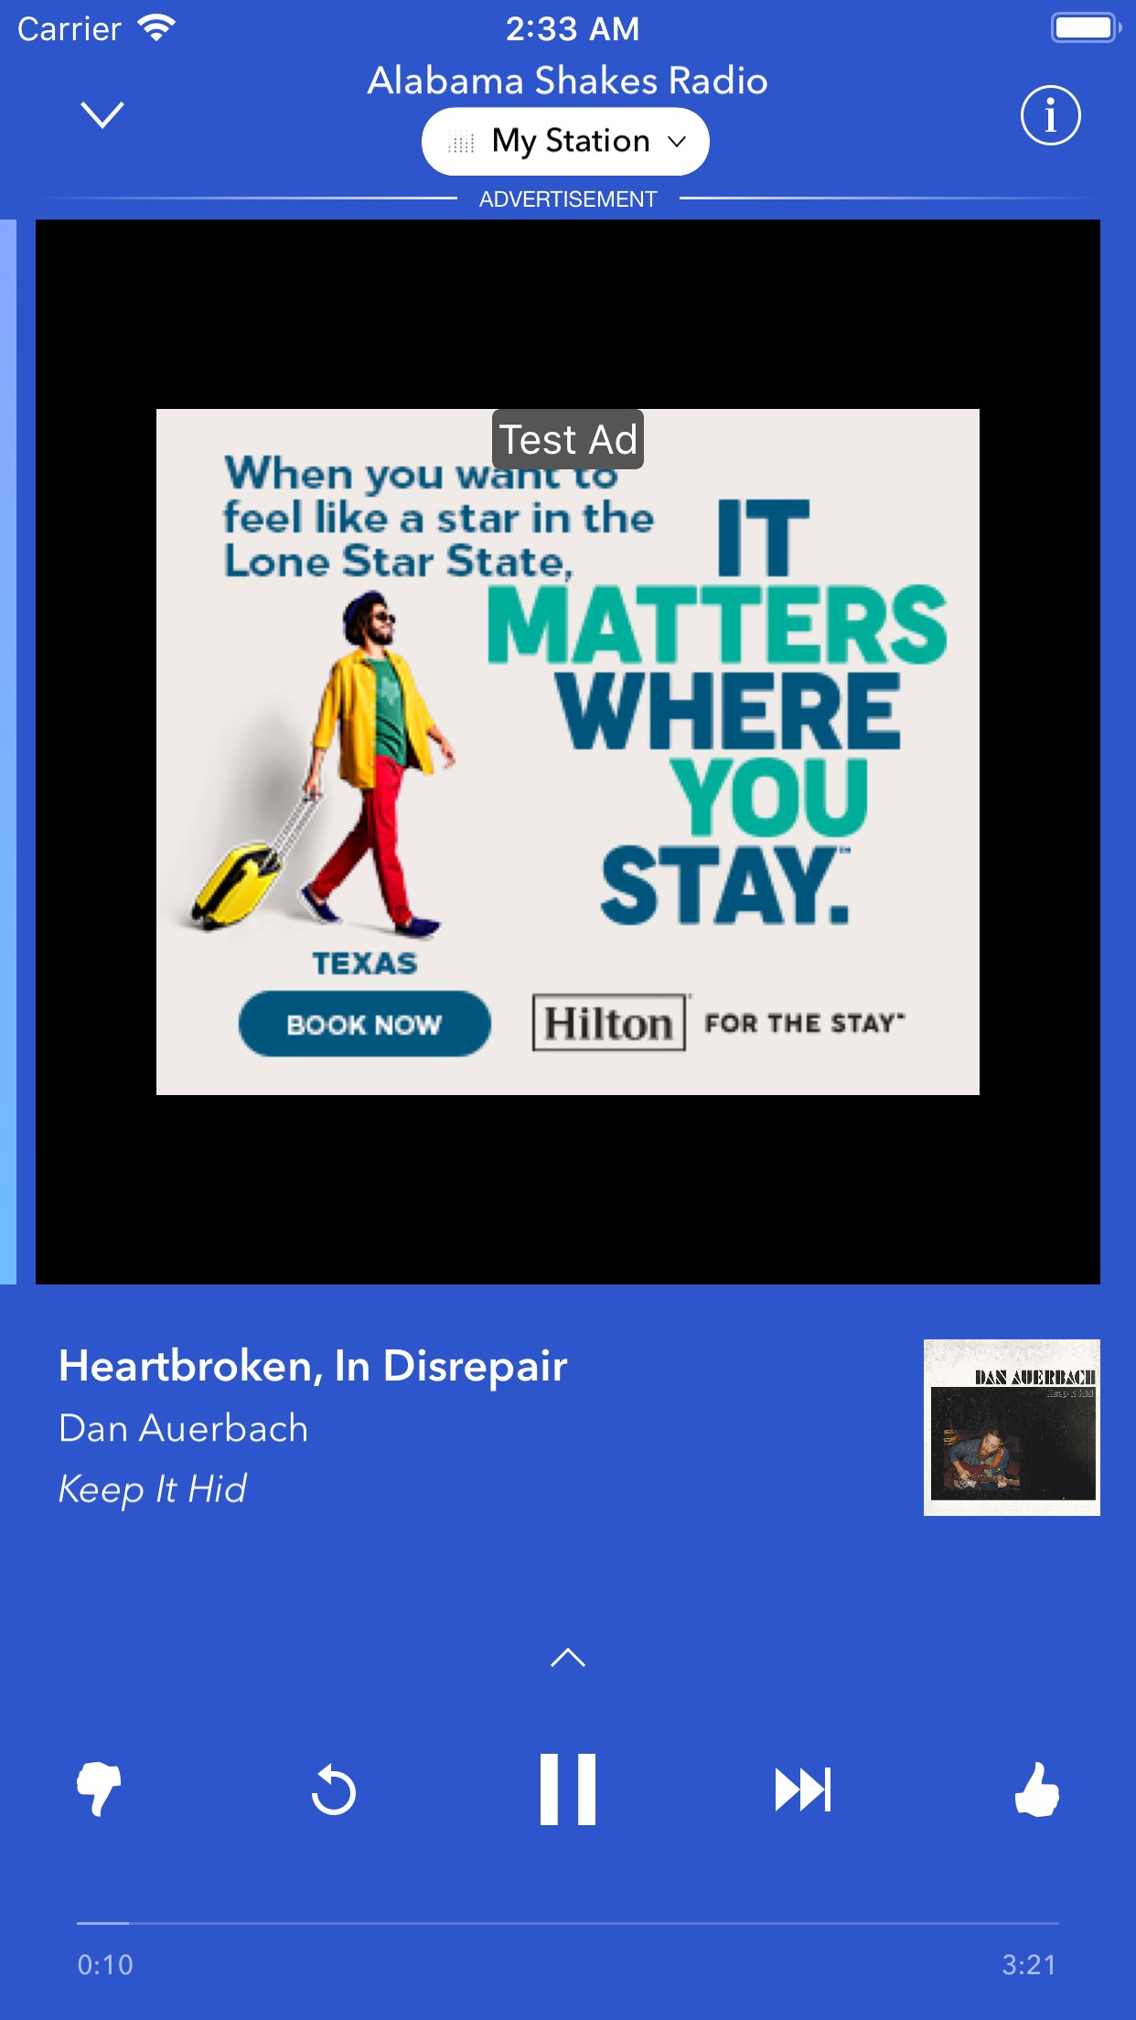
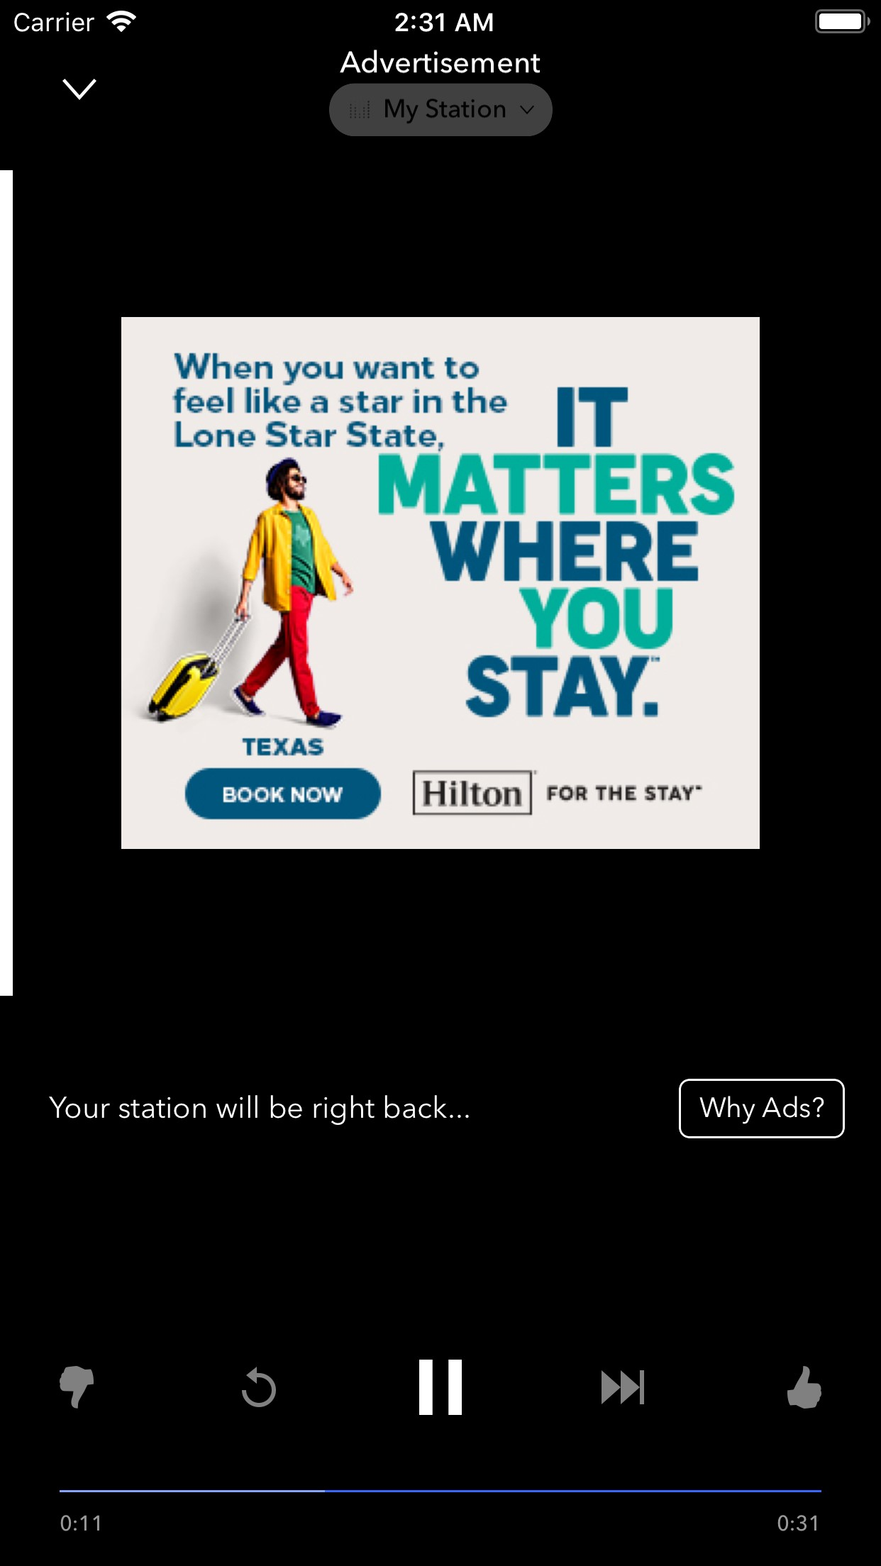
MAIN MENU
Audio: Low cost streaming audio
DETAILS: Custom audio content across multiple offerings leveraging Texas’s spend for reduced CPMs
COST: $1,000/product minimum (No minimum number of months)
Products Offered:
Sirius XM Podcast Network
Mobile Streaming
Cross Device Display
Car Play Streaming

Slide 23
MAIN MENU
Audio: Low cost streaming audio
SIRIUS XM PODCAST NETWORK
Cost efficient way to execute podcast campaigns. Content is available wherever the consumer decides to consumer their podcast content
MOBILE STREAMING
Streaming audio ads showcased across premium inventory sources of Pandora and SoundCloud
CROSS DEVICE DISPLAY
Drive user action through display ads that are served based on user-interaction so you reach a leaned-in listener
CARPLAY AUDIO
Drive user action through display ads that are served based on user-interaction so you reach a leaned-in listener

Slide 24
MAIN MENU
Audio: Low cost streaming audio
AVAILABILITY: Unlimited
CREATIVE REQUIREMENTS:
30s audio spot 300x250 companion ad
Click through URL
Pandora can record 1 script if needed
LAUNCH LEAD TIME: Creative materials due 4 weeks prior to start date
*0.18% CTR for companion banners. Audio placements are not clickable

Slide 25
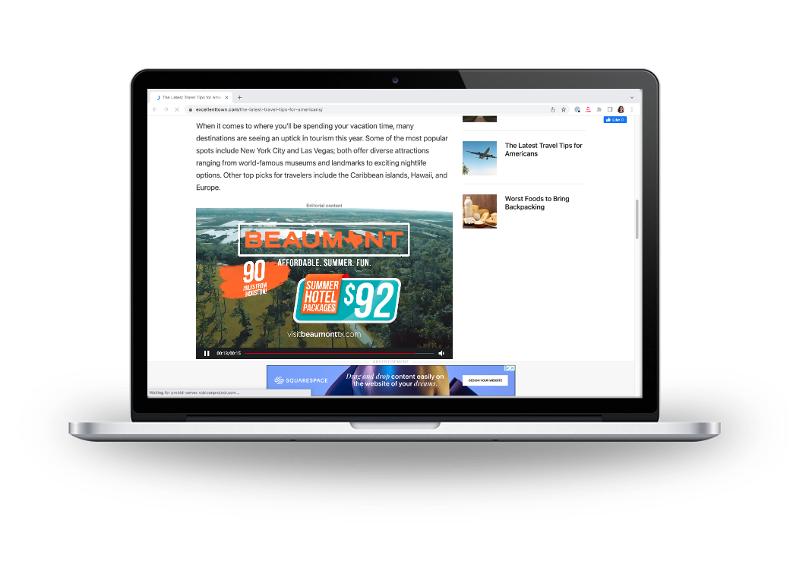
MAIN MENU
Video: Target travel intenders through OLV
DETAILS: :15s or :30s online video (OLV) ads on desktop and mobile devices targeting travel intenders
COST: $2,000/month minimum (No minimum number of months)
AVAILABILITY: Unlimited

Slide 26
MAIN MENU
Video: Target travel intenders through OLV
CREATIVE REQUIREMENTS:
:15s or :30s horizontal video
Click through URL
Maximum 2 Creatives
LAUNCH LEAD TIME: Creative materials due 4 weeks prior to start date
*63% VCR Benchmark
1.67% CTR Benchmark

Slide 27
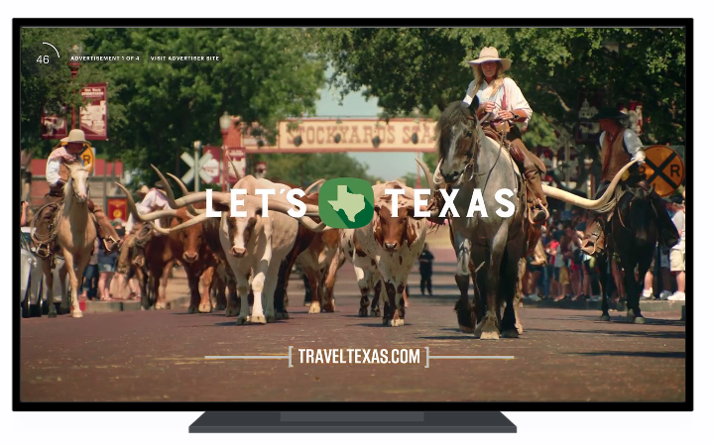
MAIN MENU
Video: Reach CTV viewers
DETAILS: :15s or :30s ads running on CTV/FEP (Full Episode Player)
COST:
Tier 1: $1,000/month (34K impressions)
Tier 2: $2,500/month (86K impressions)
Tier 3: $5,000/month (172K impressions)
AVAILABILITY: Unlimited

Slide 28
MAIN MENU
Video: Reach CTV viewers
CREATIVE REQUIREMENTS:
:15s or :30s horizontal video
Click through URL
Maximum 2 Creatives
LAUNCH LEAD TIME: Creative materials due 4 weeks prior to start date
*99% VCR Benchmark

Slide 29
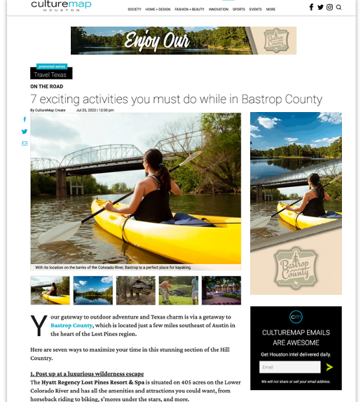
MAIN MENU
Content: CultureMap Promoted Articles
DETAILS: Custom article with cross-platform promotion through CM’s Travel category, Daily Digest newsletter, plus CM’s Facebook and Twitter
COST:
$7,250 per article
Articles will run across all five CultureMap markets (Austin, Dallas, Fort Worth, Houston, and San Antonio)
Article repromotion: PENDING

Slide 30
MAIN MENU
Content: CultureMap Promoted Articles
CREATIVE REQUIREMENTS:
Completed Content Brief
At least 1 high-res horizontal image
Click through URL
CREATIVE (OPTIONAL):
Banner ad sizes: 728x90, 300x600, 300x250, 320x100 (All must be provided to surround your article)
LAUNCH LEAD TIME: Creative Brief due 8 weeks prior to start Creative materials due 4 weeks prior to start date

Slide 31
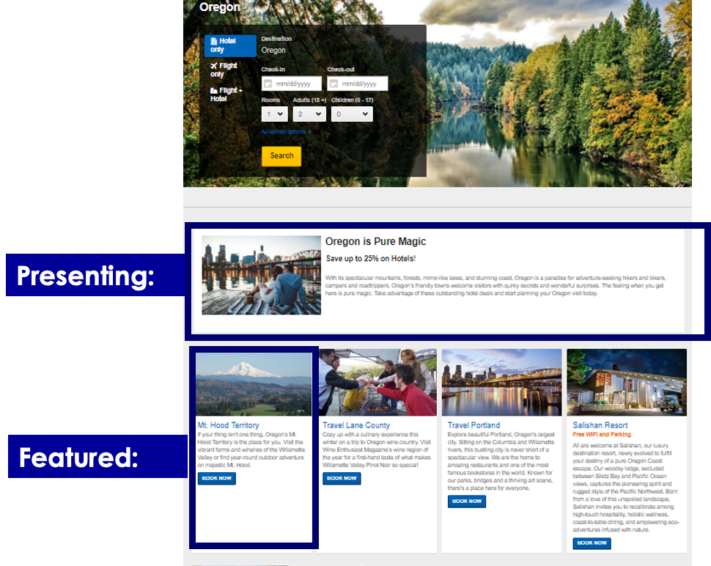
MAIN MENU
Content: Expedia Regional Landing Pages
DETAILS: Targeted media drives to campaign landing page created by Expedia based on the 7 regions of Texas
(Hill Country, Piney Woods, Prairies & Lakes, Big Bend Country, Gulf Coast, South Texas Plains, Panhandle Plains)
Regional landing page can drive back to DMO website or directly to an Expedia booking page
COST:
Presenting Tier: $8K/month or $40K over the 5 months
(2 per region, 14 total)
Featured Tier: $3K/month or $15K over the 5 months
(8 per region, 56 total)

Slide 32
MAIN MENU
Content: Expedia Regional Landing Pages
CREATIVE REQUIREMENTS:
1 high-res Hero Image that best represents your destination or attraction
Description Text: 350 characters max including spaces. Use this short blurb to tell us what your attraction/destination is all about! Your copy may be edited down if over the limit.
LAUNCH LEAD TIME: All creative will be due no later than mid-January. Expedia will create ads and the landing page with the image and copy provided.
AVAILABILITY: 70 Spots Available

Slide 33
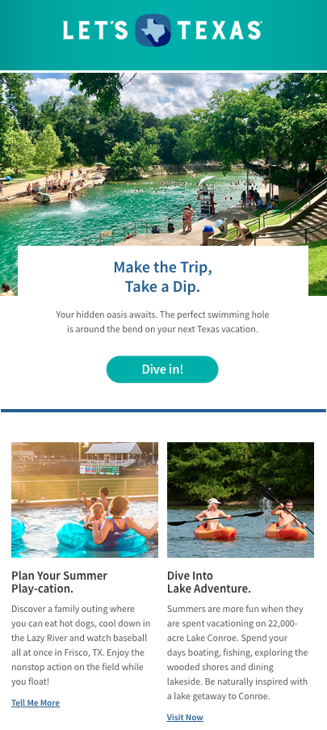
MAIN MENU
Email: Featured within Travel Texas’s monthly newsletter
DETAILS: Featured placement in monthly newsletter that goes out to over 850K opt-in subscribers
COST: $500 per email
AVAILABILITY: 16 Spots total
Limited to 1 placement per partner

Slide 34
MAIN MENU
Email: 16 total spots available
Sign ups are time-stamped and will be first come, first serve
Placements are limited
Partners to select 1 month and 1 backup month at sign up
Month | Co-Op Theme #1 | Co-Op Theme #2
February 2023 | Texas' Perfect February Getaways
March 2023 | Saddle Up for a Texan Rodeo Adventure!
April 2023 | Spring Time Adventure: Exploring Texas State Parks
May 2023 | Not available (100% Travel Texas messaging)
June 2023 | Family Adventures in the Lone Star State
July 2023 | Stars, Stripes & Sandy Shores: Celebrate on Texas Beaches
August 2023 | Unique Places to Stay Across the State
September 2023 | Sports Galore in Texas!
October 2023 | Haunted Texas and Ghostly Adventures

Slide 35
MAIN MENU
Email: Featured within Travel Texas’s monthly newsletter
Available FY25
CREATIVE REQUIREMENTS:
Image Headline
Body Copy
CTA
Click through URL
Signed image release
LAUNCH LEAD TIME: Creative materials due 4 weeks prior to email send date

Slide 36
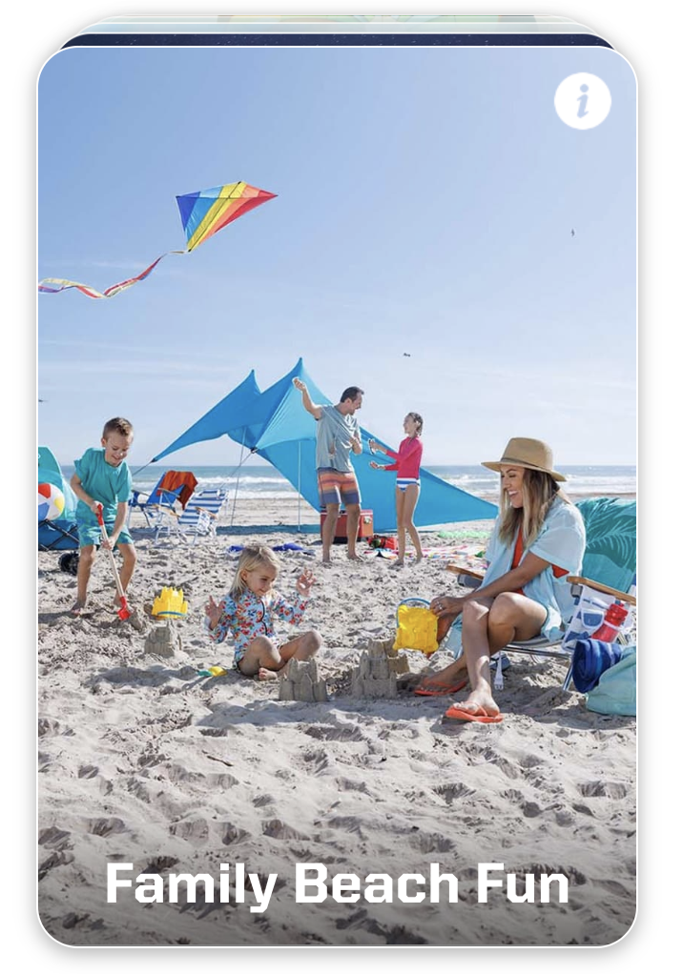
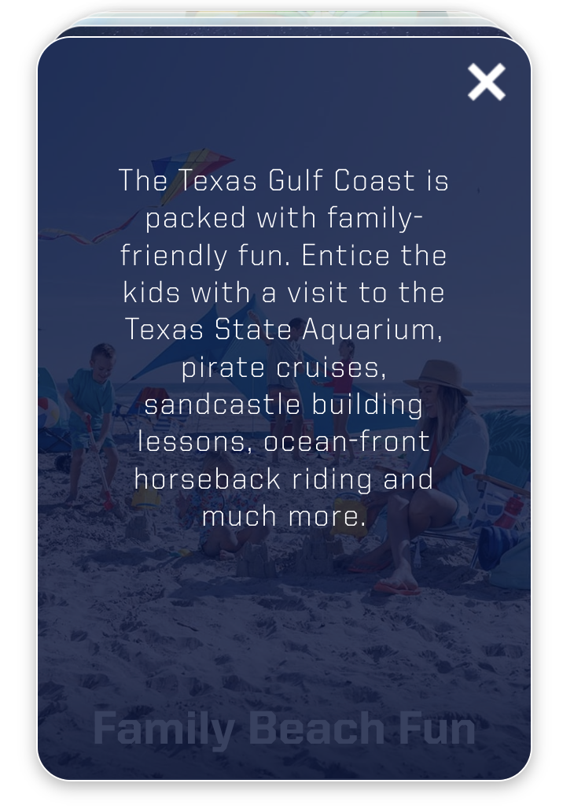
MAIN MENU
Trip Builder Co-Op Inclusion
Available FY25
CREATIVE REQUIREMENTS:
1 high-res Hero Image that best represents your destination or attraction
Preferred Click-through URL (UTM tracking link recommended)
Category Selection (choose 1):
LAUNCH LEAD TIME: All images & category selections will be due no later than March 5th. Proof Advertising will create the copy and card mock-up with the image provided.
AVAILABILITY: 30 Spots Available
*only available to DMO’s

Slide 37
Recap of FY24 offerings
Category | Co-Op Offering | Spots Available | FY24 Pricing | Timing Available
Research | Arrivalist Visitation Dashboard | Unlimited | $5,000 (for 12 months of access) | Annual
Social | Pinterest Featured Board Or Add 10 pins to existing Featured Board from a prior year |  | $1,000 per board Updating: $100 per batch of 10 pins | Dec 2023 - Aug 2024
 | Programmatic Social Stories |  | Minimum $500 per month*
 | AARP Facebook Ads |  | Two monthly tiers: $5K or $15K
Digital | Texas Data Warehouse |  | Minimum $500 per month*
 | Mobile Speed Targeting |  | Minimum $500 per month*
 | Mobile Cost per Click (CPC) Ads |  | Minimum $500 per month*
 | AARP Digital Ads |  | Three tiers: $3.5K, $5K, $10K
Audio | Pandora Streaming Audio Products |  | $1,000 per product
Video | Online Video (OLV) |  | Minimum $2,000 per month*
 | Connected TV (CTV) |  | Three monthly tiers: $1K, $2.5K, $5K
Content | CultureMap Custom Article |  | $7,250
 | Expedia Custom Landing Page | 70 | Two monthly tiers: $3K or $8K | March - July 2024
Email | Featured Placement in Travel Texas monthly newsletter | 16 | $500 per placement | Feb - Sept 2024 except the month of May
Trip Builder | NEW: Travel Texas Trip Builder Inclusion | 30 | $500 (for a 5 month flight) | April - August 2024
Partners will be responsible for supplying all necessary creative to spec. All partner creative will click out to your specified landing page.
*Partners can choose to spend more per month. No minimum number of months required.

Slide 38
Benchmarks of FY24 offerings
Category | Co-Op Offering | Spots Available | Benchmarks
Research | Arrivalist Visitation Dashboard | Unlimited
Social | Pinterest |  | Boards average 20k+ followers
 | Programmatic Social Stories |  | .80% CTR
 | AARP Facebook Ads |  | 1.29% CTR
Digital | Texas Data Warehouse |  | .40% CTR
 | Mobile Speed Targeting |  | .07% CTR
 | Mobile Cost per Click (CPC) Ads |  | .30% CTR
 | AARP Digital Ads |  | 0.39-0.50% CTR
Audio | UPDATED: Pandora Streaming Audio Products |  | .18% CTR for companion banners *Audio placements are not clickable
Video | Online Video (OLV) |  | 63% VCR 1.67% CTR
 | NEW: Connected TV (CTV) |  | 99% VCR
Content | CultureMap Custom Article
 | NEW: Expedia Custom Landing Page | 70
Email | Featured Placement in Travel Texas monthly newsletter | 16 | 15.2% Open Rate 3.72 CTOR
Partners will be responsible for supplying all necessary creative to spec. All partner creative will click out to your specified landing page.
*Partners can choose to spend more per month. No minimum number of months required.

Slide 39
MAIN MENU
FY24 Co-Op Timeline
Sign Up
Offerings Confirmation
LOA/Estimate
Invoice
Creative
Partner Creative Approval
Launch
Monthly Report
Phase II sign-up 2/22
1 week after sign up
2-3 weeks after confirming FY24 Co-Op offerings
1 week after receiving the signed LOA / Estimate from the partner
Partners must provide assets 4 weeks before the launch date
1 week before launching
1st of each month unless specified
3-4 weeks after initial launch

Slide 40
Thank you!

