Slide 1
Texas Military Preparedness Commission 2024 Texas Military Summit

Slide 2
Mike Boyd
BG (Ret) TXARNG
Chairman
Texas Military Preparedness Commission

Slide 3
LTG Miles Brown
Deputy Commanding General
Army Futures Command

Slide 4
Brig Gen Randy P. Oakland
Commander - 502nd Air Base Wing, Joint Base San Antonio
Chair - Texas Commanders Council

Slide 5
Texas Military Summit
Texas Commanders Council
Brig Gen Randy P. Oakland
Joint Base San Antonio

Slide 6
who we are
COL Stokes COL Gallagher COL Fajardo
COL Consedine
Brig Gen Oakland
Brig Gen Filcek
Col Ellison
Col Maguinness
Col Spanier
CAPT Jurica
CAPT Hufstetler
CAPT Bishop
Col French

Slide 7
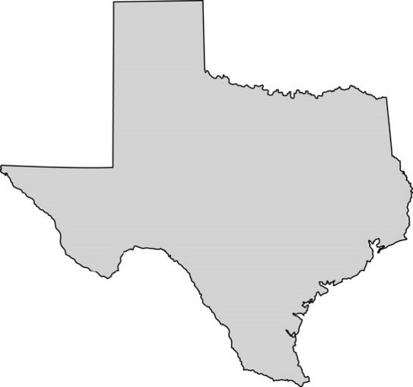
tcc installations – air force
Sheppard AFB
Dyess AFB
Goodfellow AFB
Joint Base San Antonio
Camp Bullis
Ft Sam Houston
Randolph
Laughlin AFB
Lackland
Seguin
Ellington Field JRB (Texas ANG)

Slide 8
tcc installations - army
Red River Army Depot
Fort Cavazos
Fort Bliss
Camp Stanley
Corpus Christi Army Depot

Slide 9
tcc installations - navy
NAS JRB Fort Worth
NAS Corpus Christi
NAS Kingsville

Slide 10
purpose of the tcc
To provide a forum for installation Commanders throughout Texas to promote cooperation, exchange ideas and resolve encroachment concerns impacting ongoing military operations.

Slide 11
how we serve
We work to not only mitigate installation and training area encroachment concerns, but we also work within our state and communities to further military‐family resilience.

Slide 12
impact
State & local laws, rules and regulations can pose both positive and negative impacts to mission sustainment and installation mission growth.
The TCC, through the TMPC and The Governors Committee to Support the Military works to ensure current and future mission concerns are recognized at all levels of government.

Slide 13
engaging governments
What Can the TCC Do?

Slide 14
what’s important to the tcc
Installation training requirements and local encroachment impacts are unique, but we all share many of the same common issues
Military and State Interoperability
Airspace Compatibility Impacts
Quality of life

Slide 15
texas military summit
On behalf of the TCC, thanks for your participation.

Slide 16
Brig. Gen. Michael J. Lovell USAF (Ret) & DAF
Executive Director, JBSA-EDI & 5G

Slide 17
San Antonio Electromagnetic Defense Military Readiness Enabled by Community Resilience
“Military Energy Resilience” briefing for Texas Military Summit
16 December 2024
Brig Gen Michael “Apollo” Lovell, USAF (Ret) & DAF / michael.lovell.3@us.af.mil
17

Slide 18
The United States is in a period of renewed Great Power Competition with a rising People’s Republic of China (PRC) and a revisionist Russia
18
18

Slide 19
19 Mar 2024: US & FVEY Intelligence Partners (Australia, Canada, New Zealand & United Kingdom)
issued warning on China’s Volt Typhoon targeting critical infrastructure
19
19

Slide 20
FY22 NDAA; 10 USC § 2920 (Ch. 173) Energy Resilience & Security on Military Installations
(a) Energy Resilience Measures:
SECDEF by end of FY2030 provide 100% of the energy load to maintain critical missions on each installation at 99.9% availability
“Critical Mission” defined as “missions of an installation, including mission essential operations critical to successful performance of strategic national defense, including headquarters, airfields, and supporting infrastructure…cyber operations (e.g. data centers)
Energy defined as electricity, natural gas, steam, chilled water & heated water
FY23 NDAA (10 USC § 2911): Aggregates energy conservation & resilience
20

Slide 21
Electrical demand outpacing generation…
21
21
21

Slide 22
Electrical demand outpacing generation…Big Tech’s response:
2.3 Gigawatt under new contracts:
Amazon Web Services - Contracted 960 MW from Talen Energy's Susquehanna nuclear power plant in Pennsylvania (5 Mar 2024)
Microsoft - Agreement with Constellation Energy to restart the Unit 1 reactor at Three Mile Island for 835 MW (15 Sep 2024)
Google - Deal with Kairos Power to deploy a fleet of nuclear power projects totaling 500 MW by 2035 (10 Oct 2024)
1-4 Gigawatt Requests for Proposals:
Meta: 1 to 4 GW of new nuclear generation to power its data centers and AI operations (4 Dec 2024)
New Construction:
Amazon - Several small modular reactors (SMRs) in Virginia and Washington state, including an investment in X-Energy (12 Oct 2024)
Moving beyond Renewables to meet demand with Reliable energy
22
22
22

Slide 23
San Antonio Electromagnetic Defense - Line of Effort #1 Energy Infrastructure Resilience
23

Slide 24
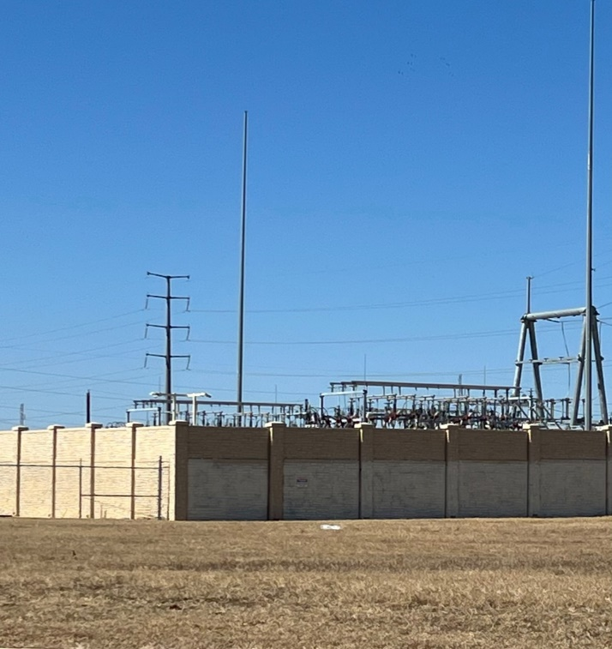
JBSA Energy Infrastructure Resilience
Completed with Texas DEAAG
Electrical Substation Hardening
2020 - 2022:
Substation Hardening: Complete
$9.4 million total military value
$5 million via Texas Defense Economic
Adjustment Assistance Grant
$4.4 million via CPS Energy matching
funds & in-kind services
2022 – 2024:
Water Pumping Stations: Complete
$21.5 million total military value
$5 million via Texas Defense Economic
Adjustment Assistance Grant
$16.5 million via matching funds & in-kind
services from SAWS & CPS Energy
Back-up Power for Water
8
24

Slide 25
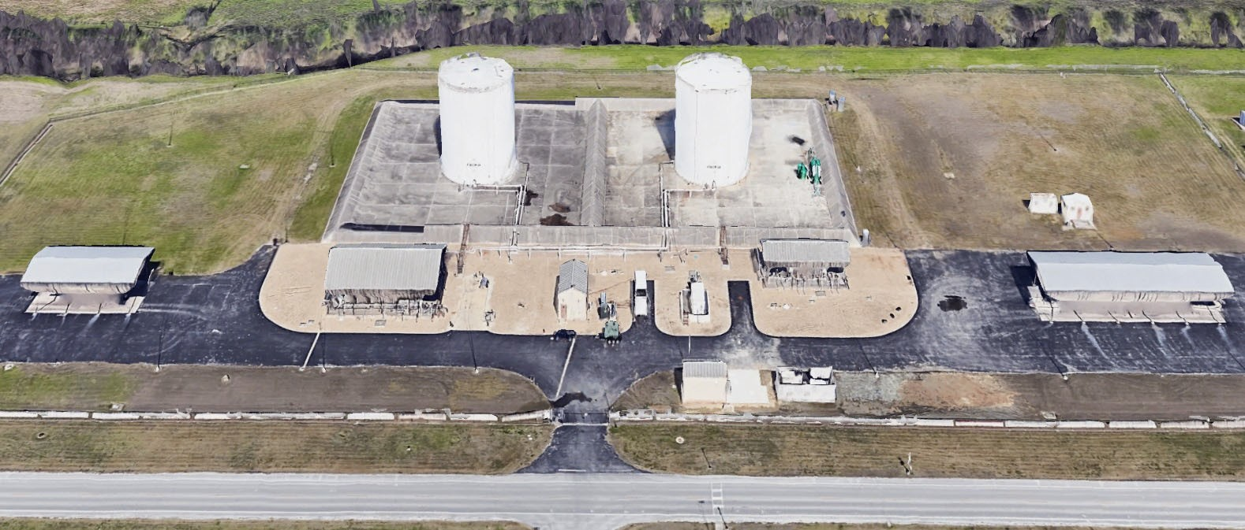
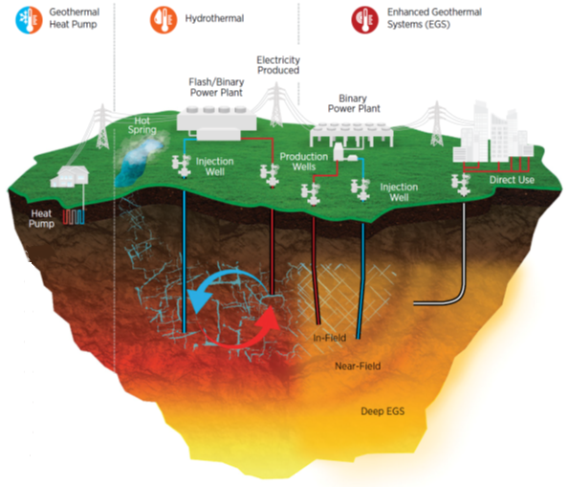
JBSA Energy Infrastructure Resilience
Current Projects
OT Cybersecurity Demo
OT Cybersecurity Demo
Geothermal Prototype
JBSA RFI to Industry
8
25
25

Slide 26
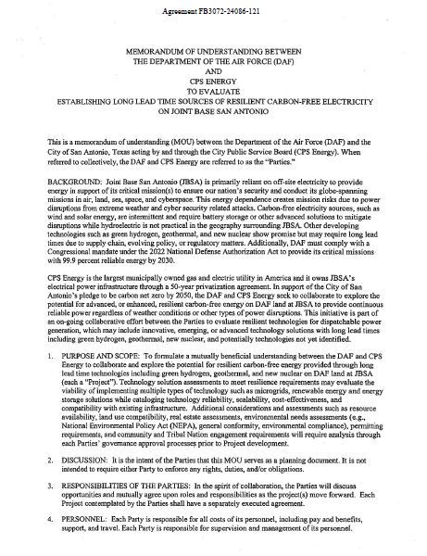
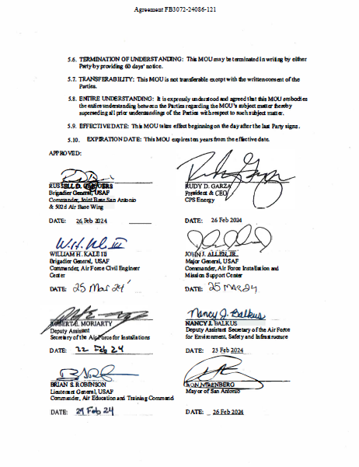
Evaluating all Resilient Energy
FEB 2024 MOU:
In support of San Antonio’s pledge to be carbon net zero by 2050, the AF and CPS Energy seek to collaborate to evaluate resilient technologies for dispatchable power generation, which may include advanced technology solutions with long lead times such as green hydrogen, geothermal, and new nuclear.
NDAA 2022 requires AF provide critical missions 99.9% reliable energy by 2030
JBSA is one of the largest AF installations and spends ~$48.5M annually on its energy consumption
2,347 BBTU of facilities’ fuel
1,522 BBTU or 445,931 Megawatts of electrical
26

Slide 27
JBSA Geothermal Prototype
JBSA-Chapman Annex
SAF/OEA sponsored
Sep 23 Contract Awarded
As a Prototype, designed to go fast & learn faster
Utility-scale advanced geothermal energy system
Environmental & Bureau of Land Management processes identified & resolved
Feasibility study determined heat element at depth in San Antonio not feasible with anticipated technology
Prototype curtailed in June 2024
Should technology breakthroughs occur, JBSA may resume the program
27

Slide 28
“Texas has long been the energy capital of the world, and today we have an incredible opportunity to build a world-leading advanced nuclear industry that will deliver safe, reliable power for generations to come.” --PUCT Commissioner Jimmy Glotfelty
Report includes:
Safety & Security emphasis
Seven Legislative Recommendations
Advanced reactor opportunity in San Antonio with Military & Industry
Citing of 2022 NDAA that requires the Military to provide critical mission 99.9% reliable energy by 2030
28

Slide 29
JBSA Resilient Energy RFI to Industry
Notice #FA8903-25-R-1002 listed on Sam.gov
Title: “RFI for the Air Force Strategic Real Estate Opportunities at Joint Base San Antonio”
Two development sites at JBSA identified
Seeks 99.9% Reliable Energy via long term Purchase Power Agreements
Sites provide safety & security
Long lead time sources such as green hydrogen, geothermal & new nuclear seem most promising
Lists Strategic Real Estate “Opportunities”
Cyber Security Center
Kelly Airfield
Parade Field Redevelopment
South Beach Project
Energy Resilience / METC Housing
RFI Responses due by email to SAF.JBSA.SREO@us.af.mil NLT 5pm Eastern Time on 31 Jan 2025
29

Slide 30
Energy Resilience…Final Thoughts
…for Military Commanders:
Pacing threat is attacking energy infrastructure while energy demand is surging
Power Company relationship is critical to mission success
Your Energy Manager’s responsibility is increasing exponentially
…for Texas Communities:
Energy resilience is economic development
Resilient energy projects help the base and the surrounding community
Texas DEAAG resources matched to local resources increase energy resilience
…for Energy Developers & Providers:
National security is dependent on win-win relationships with Military & Industry
Long-term Power Purchase agreements will include reliability factors
Vision: Build generation on a base where security & safety are provided by DoD
30

Slide 31
Q&A / Discussion
Military Readiness Enabled by Community Readiness

Slide 32
Fred Muerer, Moderator – Principal, Meurer Municipal Services, LLC.
Dave Leinberger - Chief, Army Community Partnerships, HQDA, ODCS G-9
(Installations)
Hector Gonzalez – Government Affairs Manager, El Paso Water
Steve Bonner, President & CEO, SONRI, Inc

Slide 33
B. Keith Graf
Executive Director
Texas Military Preparedness Commission

Slide 34
Commissioners
Texas Military Preparedness Commission
Garry Bradford
Mike Boyd (Chair)
Darrel Coleman
Tom Duncavage
Todd Fox
Dennis Lewis
J. Mark McLean
Benjamin Miranda, Jr.
Paul Norwood
Annette Sobel
Michael B. Starr
Timothy “Bounce” Strawther
Shannalea Taylor

Slide 35
Ex-Officio Members
Texas Military Preparedness Commission
Maj Gen Thomas Suelzer
Texas Adjutant General
Senator Kelly Hancock
Chair, Senate Veteran Affairs Committee
Representative Terry Wilson
Chair, Texas House Committee on Defense & Veterans’ Affairs

Slide 36
Staff
Texas Military Preparedness Commission
B. Keith Graf
Executive Director
Kolten Durham
Program Manager

Slide 37
Defense Economic Adjustment Assistance Grant (DEAAG)
During the 88th Legislative Session the Texas Legislature appropriated $30 million for DEAAG in FY 2024-2025.
DEAAG was split between fiscal years 2024 and 2025.
The Governor has requested an appropriation of $30 million for the base line budget for DEAAG and an exceptional item of an additional $20 million in his FY 2026-2027 budget request.

Slide 38
Defense Economic Adjustment Assistance Grant (DEAAG)
55 Awards totaling $129,191,053
Leveraged $293,358,734 in matching funds
and infrastructure projects total $422,549,787
ROI of 227%

Slide 39
Defense Economic Adjustment Assistance Grant (DEAAG)
Service Installations | Number of Projects | Total Funding
Army | 17 | $48,856,304
Air Force | 19 | $39,505,935
Navy | 12 | $12,265,713
Joint Bases | 7 | $28,563,100
Total $15,437,286.21

Slide 40
Defense Economic Adjustment Assistance Grant (DEAAG) FY 24-25 Round 1
Grantee | Project Description | Funding
City of Harker Heights | Fort Cavazos Railhead Energy Resilience | $5,000,000
Val Verde County | Aircraft Sunshades Construction at Laughlin AFB | $3,673,000
TexAmericas Center | Enhanced Logistics Capabilities -Locomotive Replacement | $1,500,000
Fort Worth | NAS JRB Fort Worth Anti-Terrorism Protection Security System | $300,000
El Paso | McGregor Range Booster Station Replacement Project | $4,500,000
McMullen County | McMullen Relocatable Over the Horizon Radar | $464,286.21
Total $15,437,286.21

Slide 41
Defense Economic Adjustment Assistance Grant (DEAAG) FY 24-25 Round 2
Grantee | Project Description | Funding
City of Copperas Cove | Fort Cavazos Energy Resilience Storage System | $5,000,000
City of Wichita Falls | Sheppard AFB Runway Strobe Light and Control Panel Replacement Project | $1,000,000
Ark-Tex Council of Governments | Riverbend Water Resources District Industrial Wastewater Treatment Plant | $5,000,000
City of Corpus Christi | Corpus Christi Army Depot Condensate Return Station Replacement | $330,000
Tom Green County | Goodfellow Air Force Base Defense Access Control Point | $4,821,472
Corpus Christi | Naval Air Station Corpus Christi Lift Station Modernization | $988,567.12

Slide 42
Texas Military Value Revolving Loan Fund (TMVRLF)
The Revolving Loan Fund provides a low cost source of funding for eligible communities that have been negatively or positively impacted by BRAC or a project that adds military value.
Minimum amount: $1,000,000, maximum amount is determined by the availability of funds and the creditworthiness of the applicant.
State funding is obtained through the sale of state general obligation bonds.
Roughly $200 million in bond authority is currently available to lend to a defense community.

Slide 43
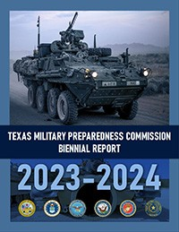
Texas Military Preparedness Commission
The new Biennial Report Released in July 2024
https://gov.texas.gov/uploads/files/organization/military/2023-2024_Biennial_Final_Updated.pdf

Slide 44
Total State Impact: $151.2 billion Total Employment – Direct 213,176, Direct and Indirect 677,022
Economic Impact
Analysis by the Texas Comptroller of Accounts
Dyess AFB - $3.6 billion
Goodfellow AFB $3.1 billion
Laughlin AFB - $1.7 billion
Sheppard AFB - $3.2 billion
Corpus Christi Army Depot $1.6 billion
Fort Bliss - $27.9 billion
Fort Cavazos - $39 billion
Red River Army Depot - $1.6 billion
Army Futures Command - $1.8 billion.
NAS Corpus Christi - $4.6 billion
NAS JRB Fort Worth - $4.8 billion
NAS Kingsville - $1 billion
Ellington Field JRB - $1.6 billion
Joint Base San Antonio - $55.1 Billion

Slide 45
Recent Events:
DOD Releases Report on Defense Spending by State in Fiscal Year 2023
Texas, Virginia, and California remain as the top recipients for overall defense spending in Fiscal Year 2023, with Texas moving to the number one spot, seeing an $8.9 billion increase over Fiscal Year 2022.
Rank State Defense Spending (billions)
1 Texas $71.6
2 Virginia $68.5
3 California $60.8
4 Florida $32.2
5 Maryland $27.8
6 Connecticut $25.3
7 Pennsylvania $21.8
8 Arizona $17.0
9 Massachusetts $16.8
10 Washington $15.5

Slide 46
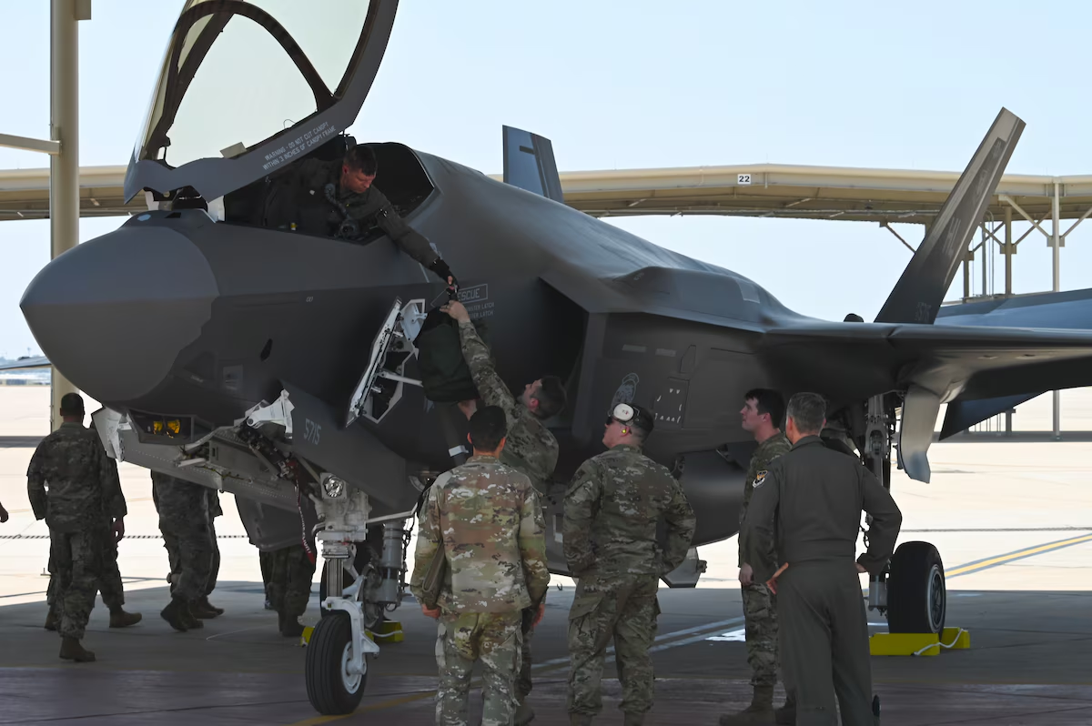
Recent Events:
Naval Air Station Joint Reserve Base Fort Worth, Texas -- The 301st Fighter Wing received its first F-35A Lightning II at Naval Air Station Joint Reserve Base Fort Worth, Texas, on Aug. 8. This arrival marked a new era in air power for the unit and Air Force Reserve Command and first reserve wing to get F-35s.

Slide 47
Recent Events:
August 2024:
Fort Worth’s Bell Textron Gets U.S. Army Approval To Build ‘Future Long-Range Assault Aircraft’ Prototypes
The V-280 Valor tiltrotor aircraft will replace the Army's famed Black Hawk combat attack helicopter—and potentially worth $70 billion across the life of the fleet.

Slide 48
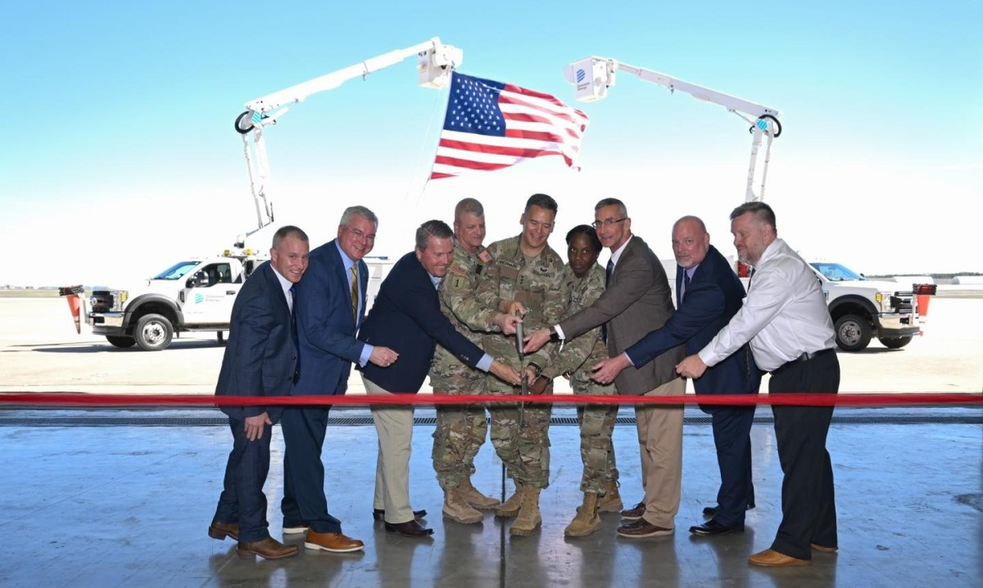
Recent Events:
February 2024:
Ceremony celebrates completion of microgrid at Fort Cavazos
Fort Cavazos, state and local leadership gathered at Robert Gray Army Airfield here for a ribbon cutting ceremony to celebrate the completion of an intelligent energy grid sustainability and restoration microgrid tool that received DEAAG funding.

Slide 49
Keith Sledd
COL (Ret., U.S. Army)
Chair
Governor’s Committee to Support the Military

Slide 50
Governor’s Committee to Support the Military

Slide 51
2024 GCSM Committee Members

Slide 52
Historical GCSM Successes
Education, Health Care, and Quality of Life
Licensure/Certification Transfer and Acceptance for Military Spouses and Teachers (2019)
Early Enrollment in School for Children of Service Members (2019 & 2023)
Create Texas Education Agency Military Webpage (2019)
Funding for Military Child Education Coalition (2021)
Create State Council for Interstate Compact on Educational Opportunity for Military Children (2021)
Defense Manpower Data for Texas School A-F Accountability Ratings (2023)
Workforce Development
Create Online Information Repository for Servicemembers and Family Members (2019)
Encroachment and Infrastructure
Allow TXDOT Interagency Contracts with Military Installations (2021 & 2023)
Fully Fund the Defense Economic Adjustment Assistance Grant (2019, 2021, & 2023)
Prohibits Operation of Non-Military Unmanned Aircraft over Military Installations (2021)
Add US Army CID and USAF OSI to Texas Criminal Code as recognized LEOs (2021)

Slide 53
2024 GCSM Report
2024 Report for Governor’s Committee to Support the Military
GCSM submitted the final report to the Governor’s office on 23 September 2024.
Currently being reviewed by Governor’s Policy Office.
Education, Health Care, and Quality of Life
Mitigate City/County Impact of Lost Property Tax Revenue for Disabled Veteran Exemption
Concurrent Jurisdiction for Juvenile Crime
Funding for Military Child Education Coalition
Texas Temporary License/Certifications for Military Spouse Licensure
Enhanced Employment Support for Military Spouses
Workforce Development
Increase Integration Between Texas Educational Providers and Military Installation/Industry Skill Requirements
Encroachment and Infrastructure
Fully Fund the Defense Economic Adjustment Assistance Grant
Encroachment on Military Installations and Training Areas
Countering Foreign Adversary Ownership of Texas Public or Private Property to Protect Military Installations/Missions

Slide 54
QUESTIONS

Slide 55
COL Vito Errico
Director of Army Software Factory
Army Futures Command

Slide 56
Serafina De Los Santos
Director – 502nd Force Support Group
Joint Base San Antonio

Slide 57
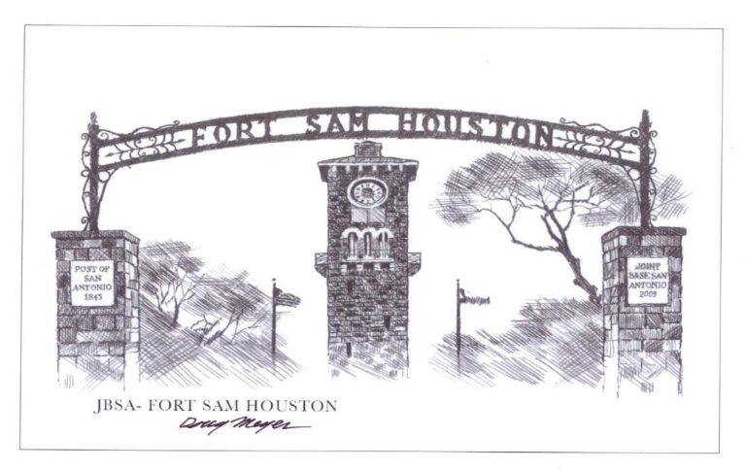
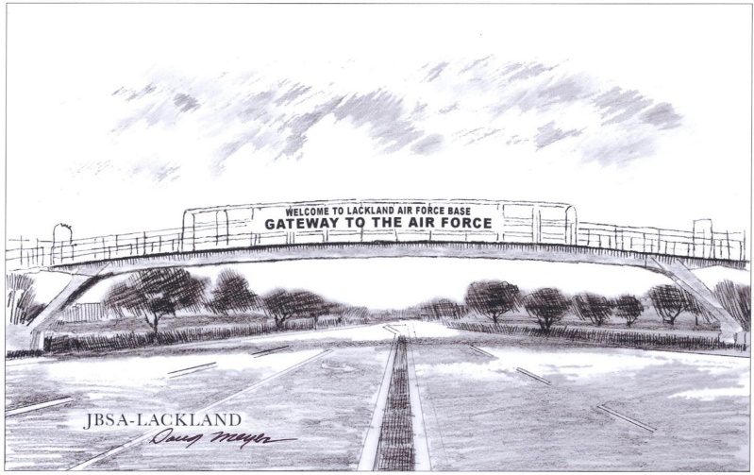
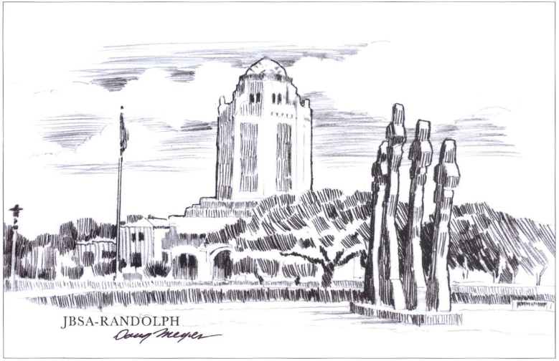
Joint Base San Antonio Workforce & Transition Alliance
Serafina De Los Santos
Executive Director
502d Force Support Group

Slide 58
Agenda
JBSA Partnerships and Initiatives
Alliance - The Why
JBSA Workforce and Transition Alliance
Transition Program and Partnerships
Five and Thrive
Military Spouses
Where do our partners fit in.
Alliance Year in Review & Metrics
Questions

Slide 59
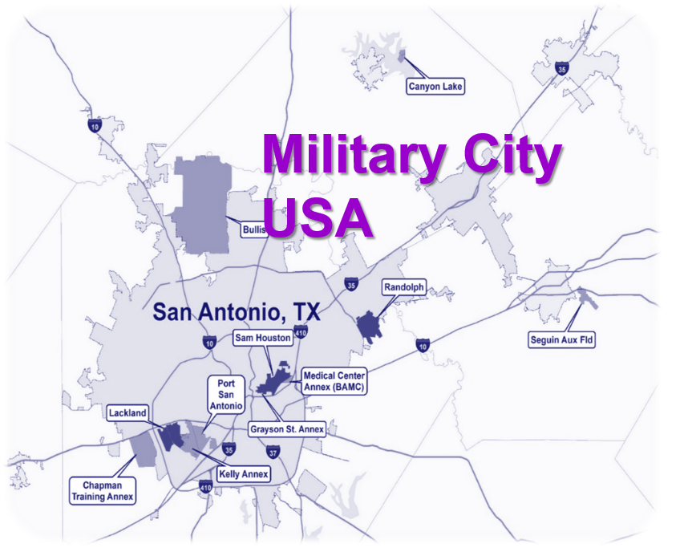
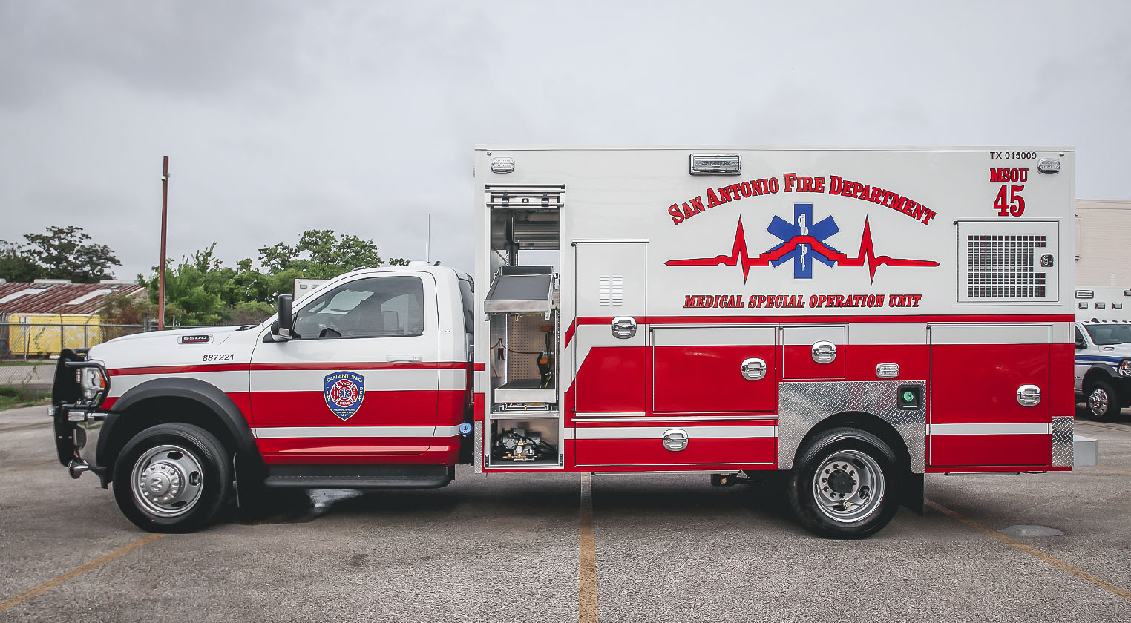
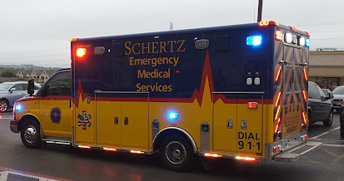
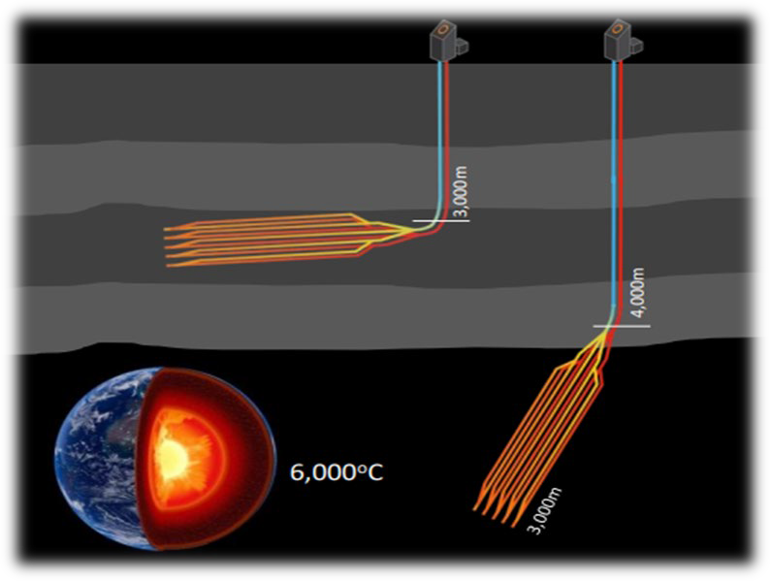
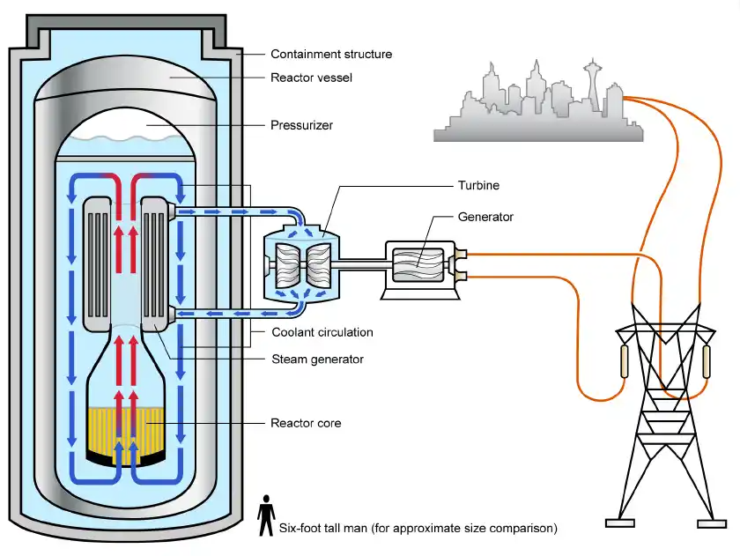
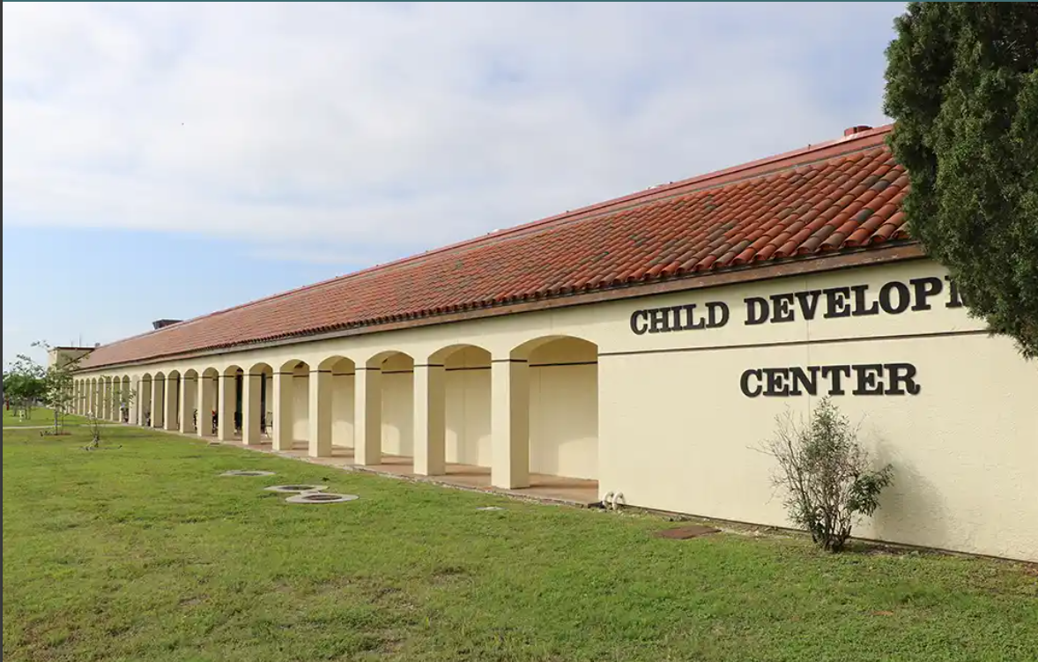
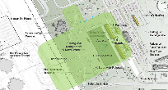
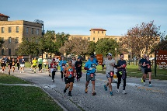
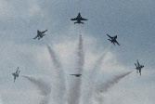
Partnerships & Initiatives
PARTNERSHIPS
JOINT BASE SAN ANTONIO
INITIATIVES
Military Installation Resiliency
Review (MIRR) Grant
T-7A Red Hawk
Ambulance Service IGSAs
MOU w/CPS Energy
Child Care Services
Lackland Next
SA Ready to Work
First Net / AT&T 5G Cellular
JBSA-Ft Sam Houston
Open House
2024
Great Texas Airshow
SA Rock & Roll Marathon
GETTING CONNECTED
Public-Public, Public-Private (P4)
Resource to community/military to preserve critical military missions/support economic vitality of the community
Contact: 502ABW.ABW.Partnership@us.af.mil
Workforce/Transition Alliance
JBSA stakeholders learn about programs outside the installation and community partners learn about JBSA.
Contact: serafina.de_los_santos.2@us.af.mil
Honorary Commanders Program
2 year program to build relationships between JBSA
and local community.
Contact: 502ABW.PA.official@us.af.mil
Notes:
PARTNERSHIPS
MIRR
JBSA MIRR Background: The Alamo Area Council of Governments (AACOG) has received a Grant from the Office of Local Defense Community Cooperation (OLDCC) in order to conduct a resiliency study identifying the risks, hazards, and vulnerabilities of the region’s infrastructure which supports JBSA-Fort Sam Houston, JBSA-Lackland, Kelly Field and Port San Antonio. (Sep 23) AACOG selected Matrix Design Group, INC at the contracted firm to execute the study.
Study focus: Study focus will be on energy, water, and wastewater infrastructure, with the period of performance of the grant being 12 months. The study, to be titled “JBSA Energy Resilience Report” will identify a prioritized list of infrastructure projects, actions, and funding plans for design and construction of the proposed projects. The study will also identify and begin or contribute to design on a few high-priority projects (This study will assist with identifying potential projects for grant opportunities (DCIP) )
Ambulance Service IGSAs
IGSA w/both SA Fire Department and City of Schertz to provide support to Fort Sam Houston, Camp Bullis, and Randolph
Benefits of the IGSA is best interest of the Gov as taxpayers will realize a savings of 12.4% ($1M) for SA and 8.13% ($314K) over five years
Child Care Services
BLUF: On 17 November we hosted the Pre.K.4. SA CEO Dr. Sarah Baray and her team for a JBSA 101 and tour to provide understanding of our organizational structure and awareness of our programs. Our expected outcome is partnering with Pre.K.4.SA more closely to provide programing for our three-to-four-year children.
1. Developed and now staffing a Draft MOU that codifies our relationship and outline how we will partner. MOU geared more to access and marketing of their programs by Pre.K. 4 SA team.
2. Include our Military & Family Readiness Centers WRT our children focused programs and how Pre.K.4.SA may assist to serve as a force multiplier for them.
3. Include our School Liaison program managers (SLPMS) in our collaborative efforts so that they can market the Pre.K.4.SA programs to our incoming families looking for options for their children.
4. Include Pre.K.4.SA in our JBSA Workforce and Transition Alliance (which they already participate in).
5. Share Pre.K.4.SA marketing material.
6. Explore transportation options for children that live on JBSA-Lackland, Randolph and Fort Sam Houston. Pre.k.4 SA stated that if they have enough children they can bus them to their locations.
7. JBSA will be included in future quarterly community meetings with PreK 4 SA, Brighton Center, and Early Matters SA for continued discussions on the expansion of MCCYN+ affiliated community childcare centers that offer fee assistance for military families.
SA Ready to Work
2023 Accomplishments
1. Completed a Memorandum of Agreement
2. Partnering with COSA to leverage opportunities with training and employment for transitioning service members, military spouses, and work age children.
3. JBSA will also partner as an employer.
4. JBSA will adopt a push-pull strategy in that the City will help JBSA with employment and training opportunities and JBSA will provide employment opportunities for those seeking employment with DoD.
2023 Rock & Roll Marathon
- On 3 Dec 23, JBSA-FSH hosted a portion of the San Antonio Rock & Roll Marathon
-- Just under 10,000 runners participated in the Full/Half marathon traversing the installation (3.2 miles through JBSA-FSH)
-- Showcased many National Register of Historic Places sites such as the Quadrangle, Old BAMC, Staff Post Housing area
-- In addition, music provided by Army Band, FSH ISD; Cole High School and Electric Pajama Party
SECAF LoC
In 2022, received SECAF Letter of Commendation for Excellence in Community Partnerships
Alliance Members providing a helping hand:
Note although the Alliance's mission is to connect external community resources with our Military & Family Readiness Centers its impact has rippled beyond its intended audience. It has proven instrumental in fortifying support structures for Veterans within the Community; revealing a cascade of secondary benefits beyond its initial focus.
1. A JBSA employee, a Veteran, was involved in a major motorcycle accident and his mother needed assistance with his VA benefits and the Alliance members assisted.
2. Helped the Mother of injured service member (an amputee) find employment when she moved to San Antonio as his primary caregiver.
3. Elderly Veteran who took up residence inside JBSA connected with Alliance member American GI Forum. Veteran was taken to VA hospital & then upon release to a nursing home.
4. Connected a Veteran working inside JBSA with assistance with utilities.
5. Connected elderly VA veteran with home renovation program and with VA services
6. Connected elderly homeless Veteran (a patient at Audie Murphy) with American GI Forum
7. JBSA Alliance members provided high touch services to Military & Family Readiness Centers by participating in workshops, helping with resume reviews, mentorship, employment coaching, networking.
8. Partnered with the 37TRW D.R.I.V.E program to provide a warm handoff to Airmen who could not finish basic training.
INITIATIVES
T-7A Red Hawk
T-7 RND beddown Schedule slipped over 1 year to the right
First Aircraft arrival FY26Q1
Initial Operational Test & Evaluation (IOT&E) FY26Q2
MOU w/CPS Energy
National Defense Authorization Act (NDAA) 2021 calls for the DoD to have 99.9% energy reliability by year 2030
To meet DoD Resiliency needs, the Air Force’s Office of Energy Assurance (OEA) is leveraging the Defense Innovation Unit's (DIU) Other Transaction Authority (OTA) to demonstrate technical feasibility and cost-effectiveness of geothermal systems across the AF Enterprise through prototyping pilots at JBSA and Mountain Home AFB
Geothermal technology is scalable, sustainable, and reliable - it's available even when the sun isn't shining and the wind isn't blowing
Successful prototypes considered for utility-scale build-outs enabling mission assurance
- In partnership with CPS Energy, JBSA signed a MOU to collaborate and explore the potential for resilient carbon‐free energy provided through long lead time
technologies.
- Coordination efforts include signatures at Secretary of AF level, AF Installation & Management, CPS Energy and the City of San Antonio Mayor.
- MOU increased in scope beyond small modular reactor development, to now include green hydrogen, geothermal, and new nuclear technologies on DAF land at JBSA.
Lackland Next
Lackland Next is the multi-year effort to improve JBSA Lackland as premier environment for all who serve, work, live, train, and visit “The Gateway to the Air Force”.
The 502 ABW will execute FSRM projects to improve the parade field and surrounding grounds every fiscal year. These projects are coordinated and prioritized through 2AF and 37TRW.
The following projects are to be executed in FY23 :
Project Est Cost
Expand Parking $.80M
Additional Shade Canopies $.85M
Jumbo Trons $1.8M
Construct ADA Bathrooms $1.0M
Install Food Truck Utilities $.75M
Total $4.2M
First Net / AT&T 5G Cellular
- First Responder Network Authority (FirstNet) is an independent government agency within the US Department of Commerce’s National Telecommunications and Information Administration (NTIA)
AT&T is in year six of a 25 year FirstNet contract
Added Benefit: AT&T’s commercial service is available to customers in same FirstNet coverage area as it transmits through same infrastructure
FirstNet’s existing data rate is faster than existing commercial cellular networks and only nationwide network that has encryption through entire route (e.g. tower, backhaul, core & back)
FirstNet applications tailored to first responders, emergency management, C2, fleet management, situational awareness, traffic safety, medical/hospital functions and public works/utilities
JBSA costs to acquire FirstNet is $0 (zero) for infrastructure & approx $25 per subscription per month
- Wing’s plan to install FirstNet cellular infrastructure at JBSA is on track to be FOC by Jul 2025 as coordination and approval will be
complete in Jun 2024, and the second year of the program is focused on construction and installation
JBSA-Ft Sam Houston Open House
22 Apr 23 JBSA-FSH will host an open house at MacArthur Parade Field and Johnson Track.
Begin with opening ceremony and conclude with fireworks display or laser light show.
Include activities, static displays, capability demonstrations, tours, food and live music.
2024 Great Texas Airshow Prep
6-7 April 2024
JBSA Randolph
Thunderbirds Showing the event
Free to the Public
Getting Connected
Public-Public, Public-Private (P4)
Partnership Lead for JBSA:
Ms. Valerie Ramirez, 502 ABW/CMI, 210-808-7521
E-mail: valerie.ramirez@us.af.mil
502 ABW Community Partnership workflow box:
502ABW.ABW.Partnership@us.af.mil
Workforce/Transition Alliance
P.O.C. Mr. Jose e. Ontiveros
JBSA Workforce & Transition Alliance
SkillBridge / Career Skills Program
Email: jose.ontiveros.4@us.af.mil
Honorary Commanders Program
2 year program
Build relationships between JBSA and local community
Promote civic engagement and community relations
Foster communication between commanders and civic leaders
Showcase JBSA
Tours of JBSA Missions
P.O.C. Ms. Kathleen Salazar
502 ABW Community Engagement Section Chief
Email: 502ABW.PA.official@us.af.mil

Slide 60
Alliance - The Why?
The Challenge?
Tremendous sea of good will in Military City, USA was inundating our JBSA staff members, service members and their families with great resources, albeit with no mechanism to manage the influx of information.
Now? The Alliance provides a link to resources that are vetted and are known to provide help and support. It is not just for transition or employment.
Why is the Alliance important to JBSA, it’s service members and their families?
When help is needed to support service members and families the Alliance response is always instantaneous.
During Thanksgiving Alliance members learned of the need for families to have a good Thanksgiving we received over 200 turkey’s for JBSA families.
Our partnership with Pre-k for SA serves as a force multiplier to our JBSA Childcare programs in ages 3-4. This is free to all active-duty service members assigned to JBSA.
Why is the Alliance beneficial to Community Partners
The alliance provides a gateway to JBSA. We educate the community on our requirements. We help them understand our Demographic.
It allows our M&FRCs to have confidence in Community resources.
It helps build trust with our transitioning service members, military spouses and family members.
It helps the Community by providing them an opportunity to have collective impact.
We help the economy by matching our service members with employers.

Slide 61
JBSA Workforce & Transition Alliance
Started in 2015
Mission Build relationships among government, non-government agencies, veteran non-profit organizations and employer partners. Coalesce opportunities for transitioning service members, military spouses, dependents, and Veterans.
JBSA Workforce & Transition Alliance
Workshops, Training
Career Fairs, Employment
High Touch Assistance
SkillBridge/ Career Skills Program
Five and Thrive Family Resources
Vision
For JBSA stakeholders to learn about programs outside the installation and for community partners to learn about JBSA and its requirements.
Goal .
Share and sync employment, education, entrepreneurship, credentialing, and holistic wellness information
While the Alliance was originally designed to assist transitioning service members, its impact has rippled beyond its intended audience. Its implementation has proven instrumental in fortifying support structures for JBSA showcasing a spectrum of secondary QOL benefits.
Meeting frequency:
Weekly on Tuesdays, 0830, via Zoom
In-person for special events & invites orgs

Slide 62
Transition Program and Partnerships

Slide 63
Transition Program thru Partnerships
Who are we trying to target?
Army, Navy, Air Force, Coast Guard, Marines, Space Force, transitioning service members
JBSA transitions approximately 4,000 service members per year
Primary skill sets white collar, Administrative, Project Managers, Medical, IT…
JBSA Objective – Foster a Warm-hand-off
Work with Government or non-governmental agencies outside our Gates to streamline and channel information to our exiting personnel
Enhance the Transition Assistance Program (TAP)
Not properly supporting the transitioning service member
Financial crisis, substance abuse, disenfranchisement, increased need for services
CAN LEAD TO

Slide 64
Transitioning from the Military Which path can they take?
Standard Track
Higher Education Track
Career Technical Training Track
Small Business Track
Goes straight into another career
Gets help with resume writing, interview skills
Gets help with networking
Involves classroom instruction
Full time student
Seeks baccalaureate or advanced degree
Gets help in accessing higher education options
Gets help with application process
Involves classes, events, off-site campus tours, university presentations
Skillbridge
Can result in a license or other credential
Internships
Job shadowing
Start a business or purchase a franchise
Can include on-site or online courses, mentorship and off-site visits to incubator programs

Slide 65
Military Spouses and Five and Thrive

Slide 66
Five and Thrive
The Five
Childcare
Education
Healthcare
Housing
Spouse Employment
Brings military leaders, community partners, and military families together to tackle the top five quality of life issues

Slide 67
Military Spouses
Department of Labor Facts
92% of military spouses are women
53% participated in the labor market
13% unemployed—about three times the national rate
89% have some college education
30% have a four-year degree, while 15% have an advanced degree
Underemployment: 31.6% of military spouses are employed part-time but may prefer full-time work
Occupational licenses: 34% of employed spouses work in occupations that require licenses.
Artificial barriers to employment:
Military families move frequently
Military spouses find it difficult to transfer licenses from state to state, delaying their return to the workforce.
Concern about limited time they can commit to any job

Slide 68
Where do our Partners Fit In?
Standard Track
Higher Education Track
University of Incarnate Word (UIW)
Texas A&M San Antonio
Career Technical Track
Clarity
Alamo Area Council of Governments (AACOG)
Health, Wellness, QOL
Entrepreneur Track
US Patent and Trademark Office
Hiring Our Heroes
SA Ready to work
H.E.B.
Onward to Opportunity
UTSA
TRICARE
Wounded Warrior Project
Steven A Cohen Mil Fam Clinic @ Endeavors
Department of Veterans Affairs
Park University
Grand Canyon University
Alamo Colleges District
Small Business Association
LiftFund
Boots to Business
Exceptional Family Member Program
Fourblock
SA Ready to Work
Alamo Area Council of Governments (AACOG)
United Way
American GI Forum
Texas Workforce Commission
Workforce Solutions Alamo
Workforce Solutions Alamo
CSP/Skillbridge
Fourblock
Alamo Colleges
Workforces Solutions Alamo
Bexar County Military and Veterans Service Center
Texas Veterans Commission
VA
Dress for Success
Texas Workforce Commission
Southwest Research Institute
Centurion Military Alliance (CMA)
Esposas Militares Hispanas
JBSA Military & Family Readiness Centers
Pre-K 4 SA
Not all inclusive

Slide 69
JBSA Workforce & Transition Alliance
2024 Year in review
540+ Members
425+ Organizations
49 Alliance Meetings
3.4K participants
260+ Events shared via Alliance Calendar & Meeting Minutes
Alliance LinkedIn – Shared Calendar, Events, and Job Postings
4.7K Members (+942)
32K Impressions (posts viewed/clicked on)
SkillBridge LinkedIn – Shared Skillbridge / CSP Opportunities
5.5K Members (+487)
20.3K Impressions (posts viewed/clicked on)

Slide 70
JBSA SkillBridge &
Workforce & Transition Alliance Partnerships
MOUs Signed
Holt Cat
Onward to Opportunity
Accenture Federal Services
Solar Ready Vets
Microsoft Software & Systems Academy
United Health Group / Optum / WellMed
CPS Energy
Hiring Our Heroes
Southwest Research Institute
Army Air Force Exchange Service
St Michale’s Learning Academy
Texas Parks & Wildlife
Business Enabled Acquisition and Technology - B.E.A.T.
International City/County Management Association - ICMA
502 Civil Engineer Group
H-E-B
SA Ready to Work (Workforce & Transition Alliance)
PreK4SA (Workforce & Transition Alliance)
MOUs In-Work
USAA - Skillbridge & Alliance
Cavender Auto Group - Skillbridge & Alliance
Dress For Success - Alliance
United Way of San Antonio - Alliance
Alamo Colleges - Alliance Workforce Development
18 MOUs signed
Five MOUs in progress

Slide 71
JBSA Workforce & Transition Alliance
2024 Traveling Roadshow
19 Mar: Meeting @ Texas A&M University at San Antonio
2 Apr: Meeting @ ESC 20
22 Apr: National Parks Service Recreational Lands Pass Event
23 Apr: Meeting @ Workforce Solutions Alamo
30 Apr: Meeting @ Bexar County @ TXFAST
21 May: Meeting @ Restore Education
18 Jun: Meeting @ Dress For Success San Antonio
30 Jul: Meeting @ Alamo Colleges Workforce Center of Excellence
Aug: Hiring Our Heroes Career Summit @ University of Incarnate Word
20 Aug: Meeting @ Family Service Good Neighborhood
13 Sep: Employer SkillBridge Panel @ Boeing Center at Tech Port
17 Oct: United States Patent & Trademark Office Entrepreneurship Workshop @ The Good Samaritan
22 Oct: Meeting @ Boeing Center at Tech Port
28-30 Oct: Association of Defense Communities Installation Innovation Forum Seminar @ Marriott Riverwalk
29 Oct: JBSA & HEB Alliance/SkillBridge MOU singing @ HEB’s Arsenal HQ
6 Nov: Hiring Red, White, & You @ Freeman Coliseum Expo Hall
3 Dec: Meeting @ JBSA-Fort Sam Houston Golf Course
16 Dec: Texas Military Summit @ Texas State Capitol
18 in person meetings

Slide 72
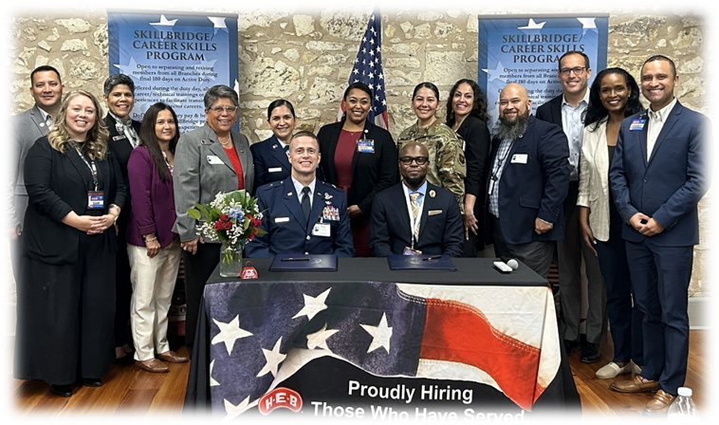
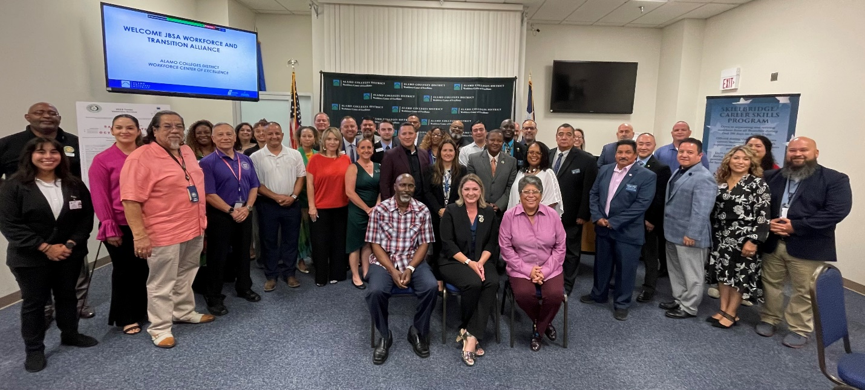
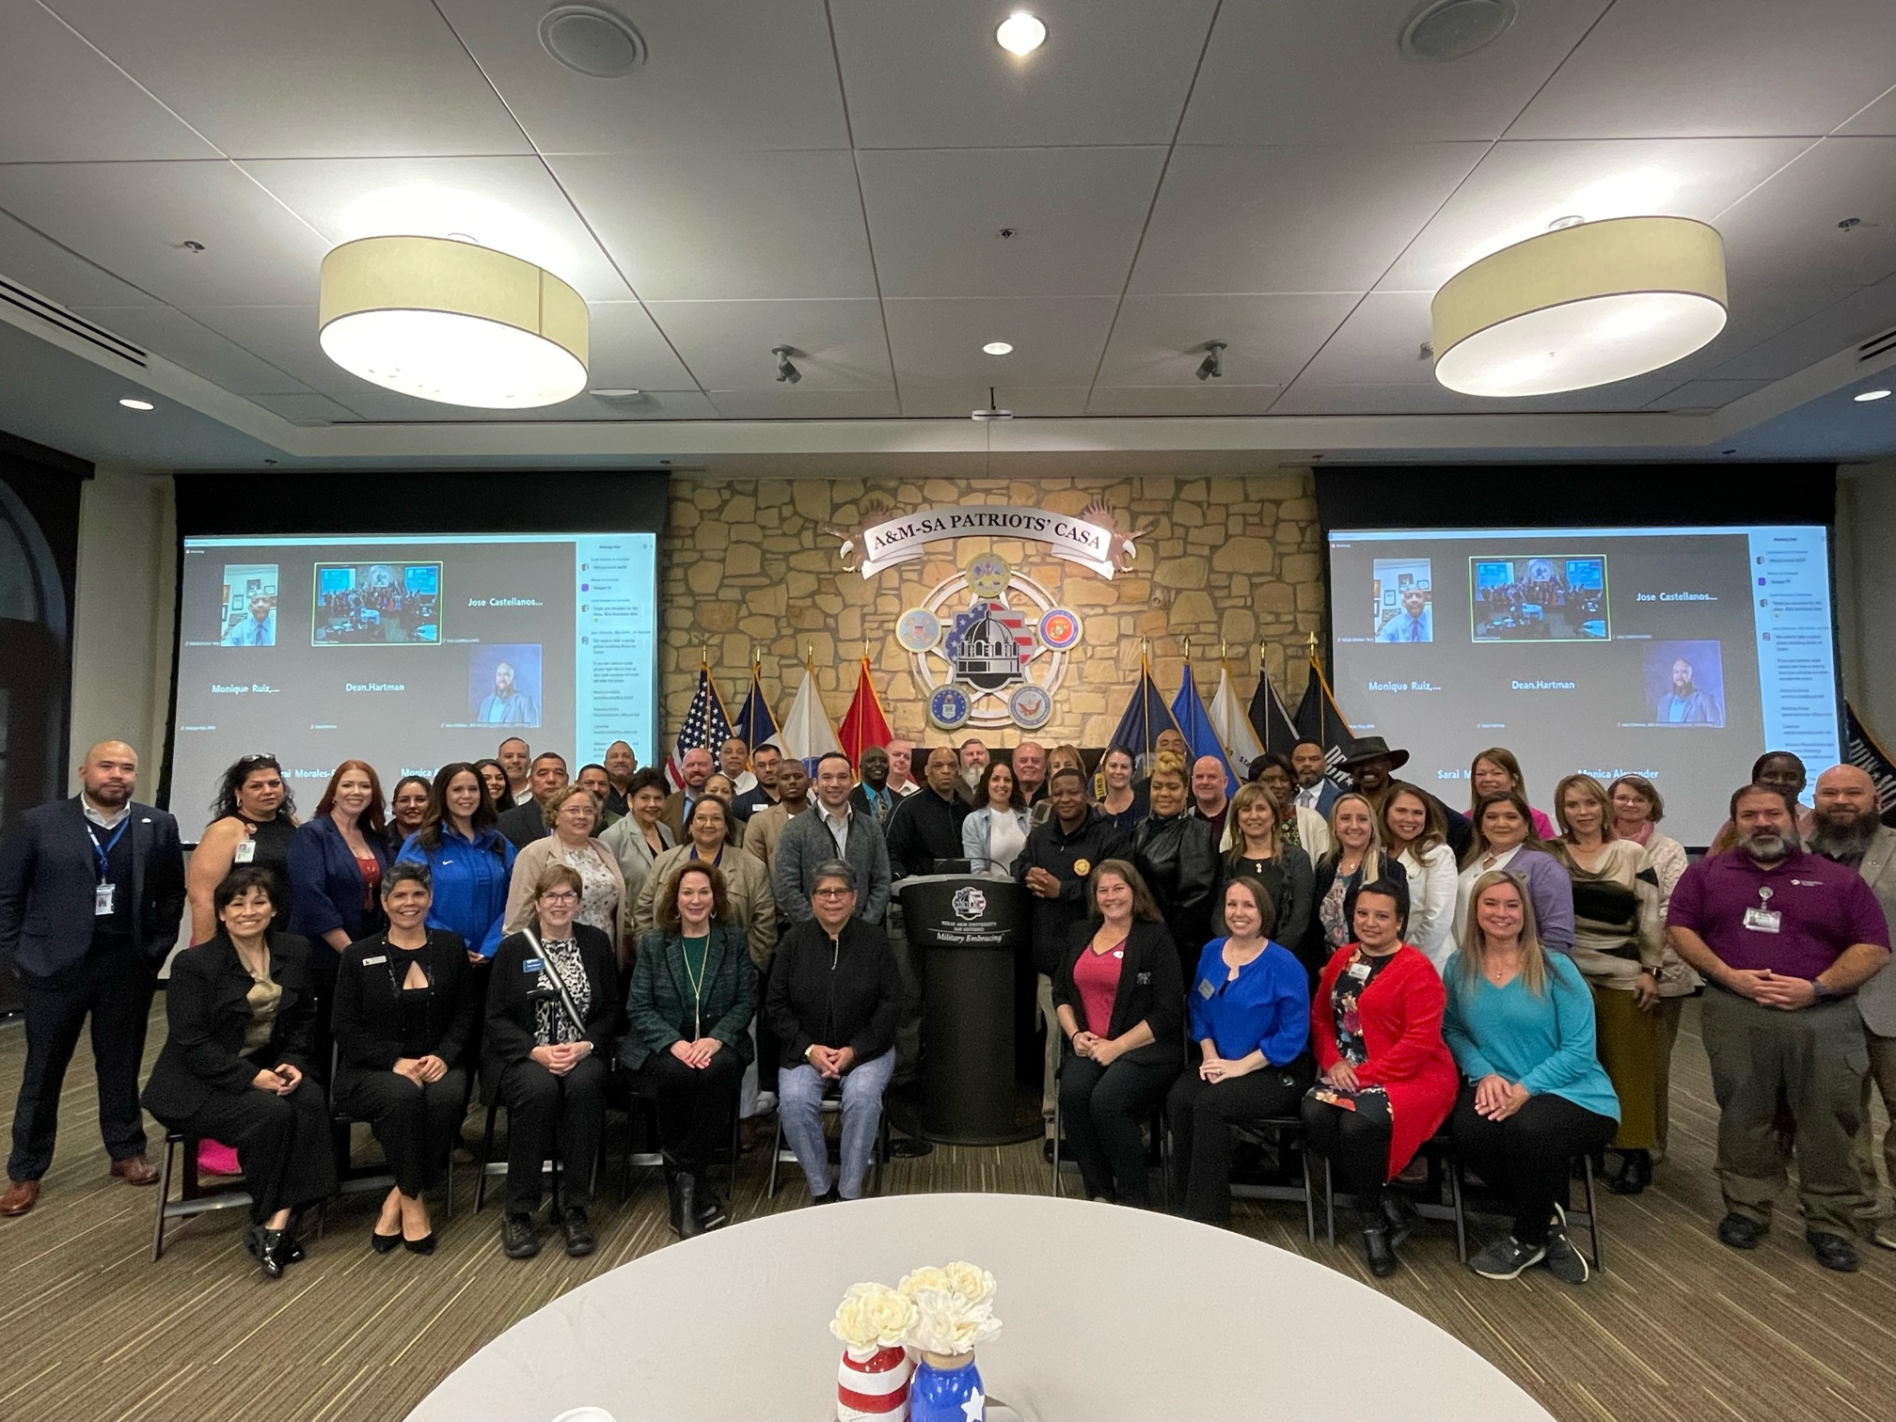
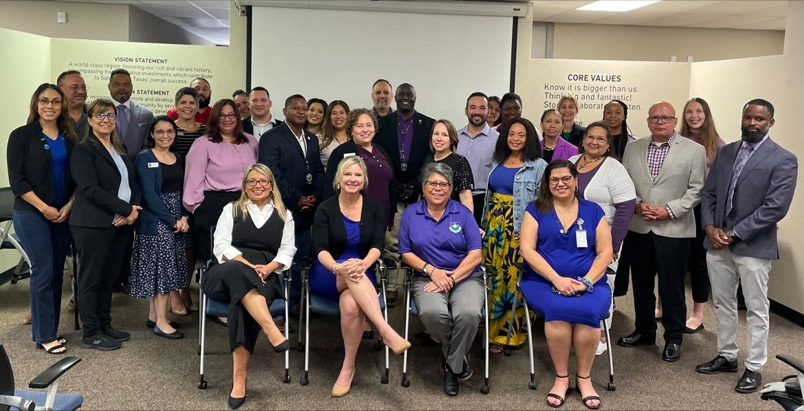
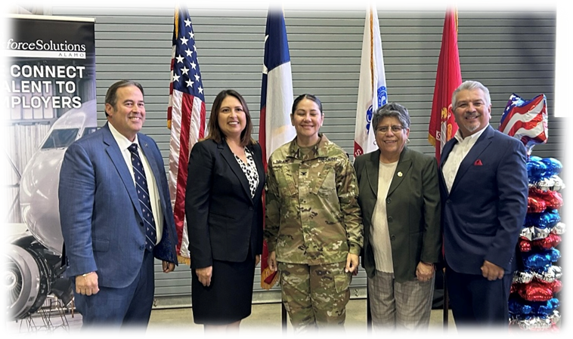
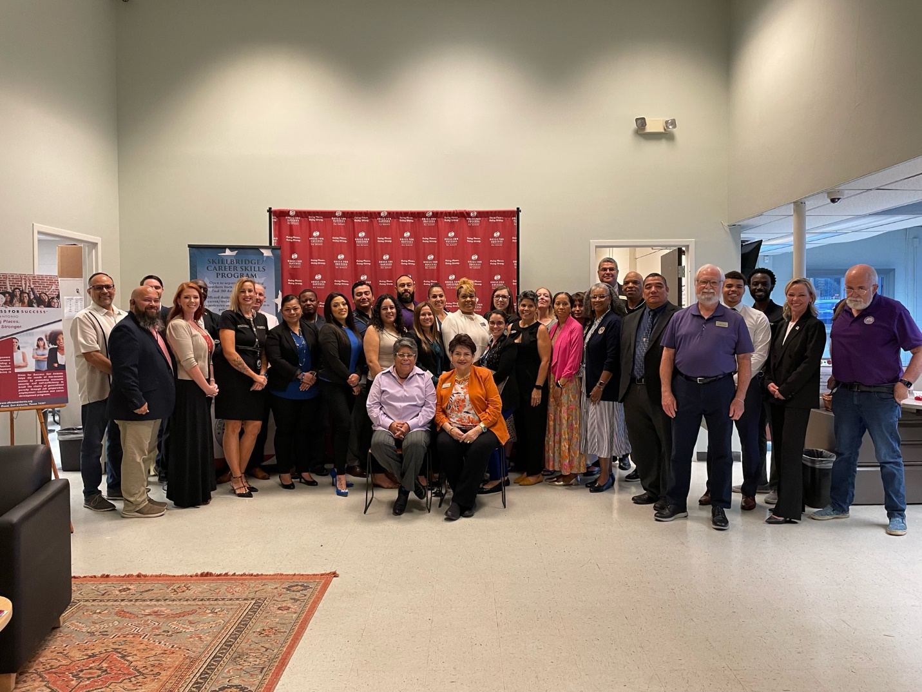
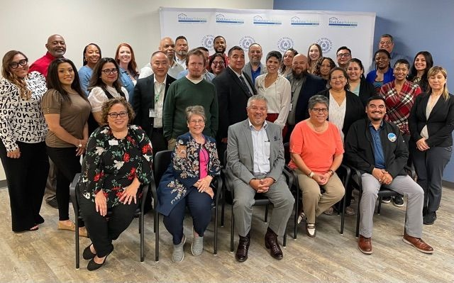
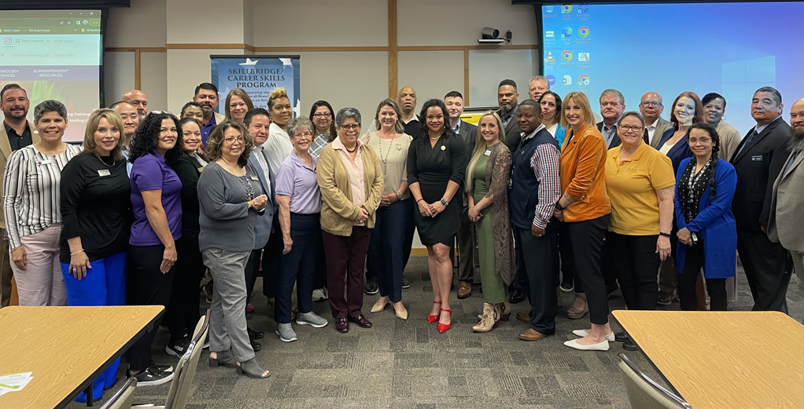
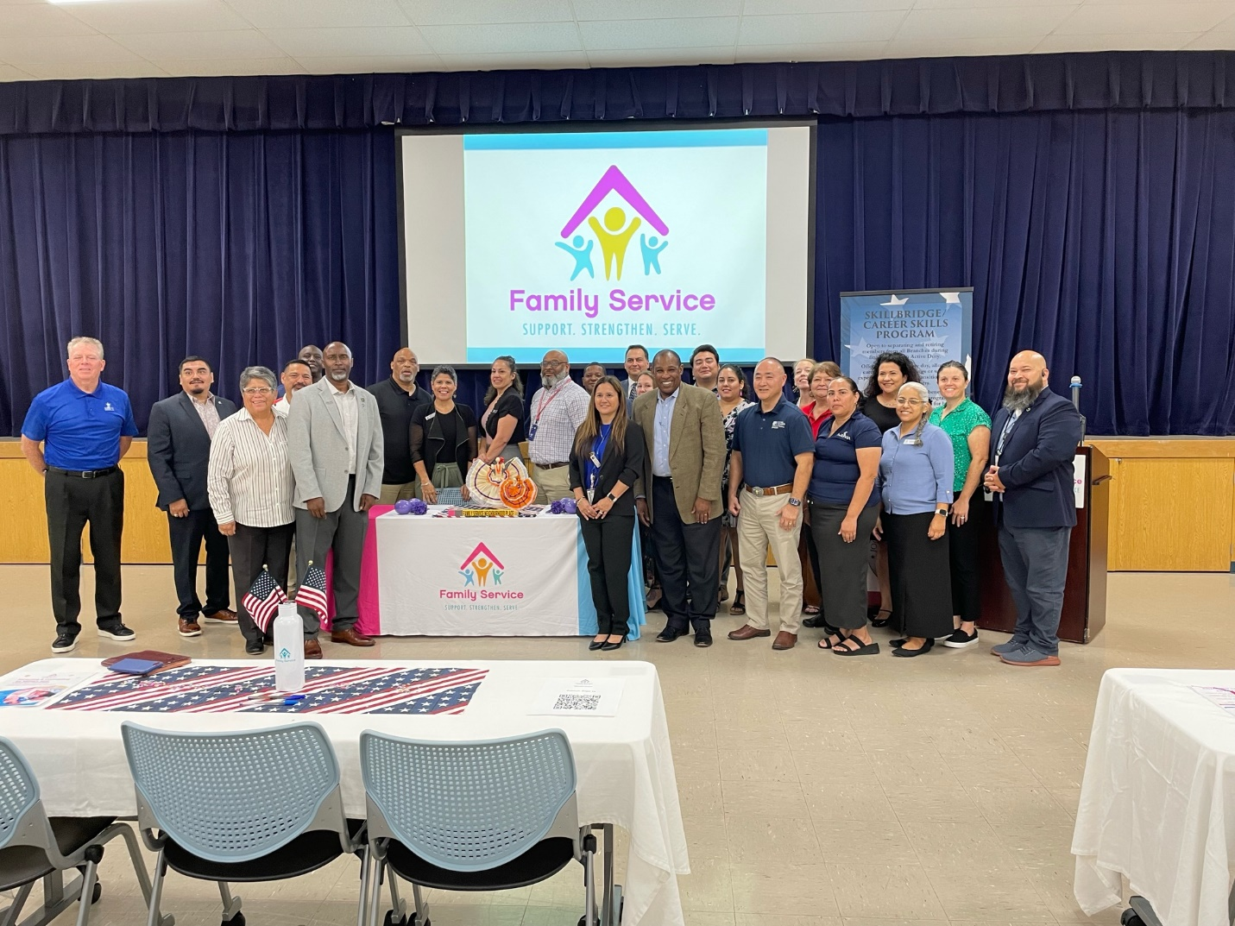
JBSA Workforce & Transition Alliance
2024 Community Engagement

Slide 73
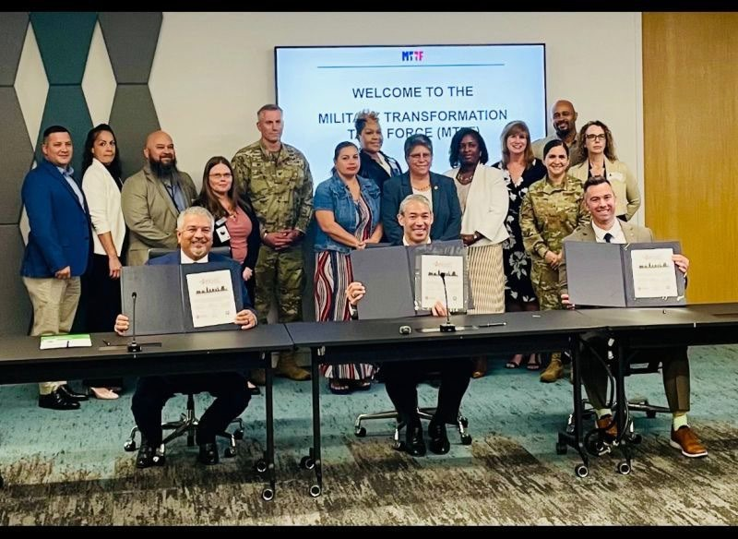
JBSA Workforce & Transition Alliance
San Antonio Ready to Work MOU Signing Ceremony
20 May 24
Signed by: Mr. Brian Hoffman 502 ABW, Mr. Ron Nirenberg, San Antonio Mayor, and Mr. Adrian Lopez CEO Workforce Solutions Alamo

Slide 74
Forming Alliances
Connect With
Transitioning Service Members
Military Spouses
Military Youth
Partnerships require leadership engagement.
Social community events are great to connect with resources
Community partners like to interact with Senior leaders not just in social settings
Deputies or XOs can/should chair recurring meetings
Partner & Participate
JBSA-Workforce and Transition Alliance
Workshops
Career Fairs
High touch assistance (resumes, coach, mentor)
Partner & Train
DoD Skillbridge Program
Apprenticeships
Internships
Employment Skills Training
Job Shadowing

Slide 75
Questions

Slide 76
Mike Boyd
BG (Ret) TXARNG
Chairman
Texas Military Preparedness Commission

