Slide 1
Texas Task Force on Concert Safety Risk Assessment
DECEMBER 9, 2021

Slide 2
DARRELL UTT, CPP, PSP
Operational Security Lead
25-years experience, former U.S. Special Forces (Green Berets)
B.S. Criminal Justice, Excelsior College
M.S. Intelligence Studies, American Public University
Former Director of Security and Director of Operations
Board-Certified in Security Management and designated as a Certified Protection Professional (CPP) and Physical Security Professional (PSP)
Expertise in Risk Assessment, High-Angle Attack Assessment (H3A), Emergency Management and Planning

Slide 3
Agenda
Risk Assessment
Primary References and Resources
Texas Mass Gatherings Act
Recommendations

Slide 4
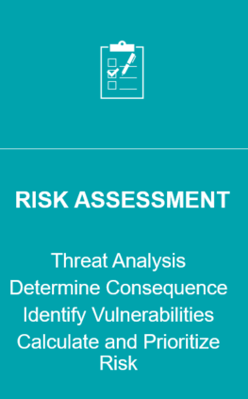
RISK ASSESSMENT
Description
Identifies threats/hazards and overall risk to property and invited guests and staff
Prioritizes threats/hazards and control measures
Determines if existing control measures are adequate or if more should be done
Enables clients to assess the probability that an adverse event may negatively impact a business, event, and/or project

Slide 5
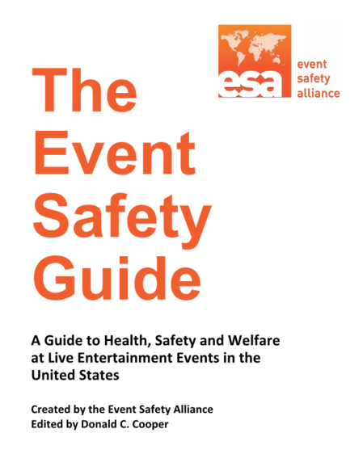
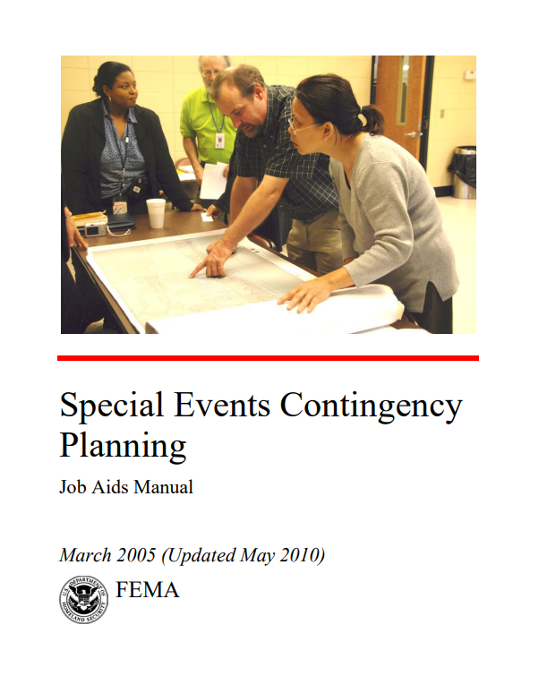
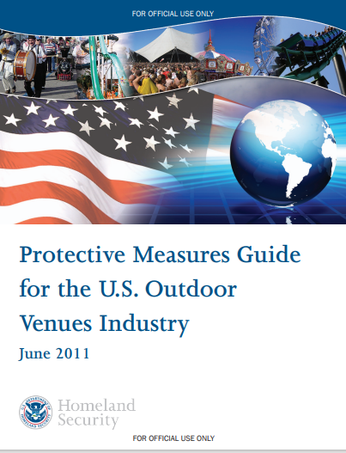
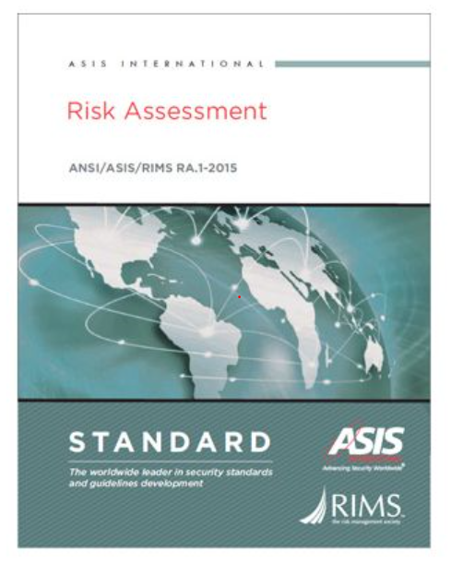
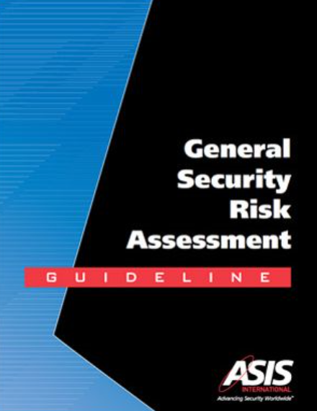
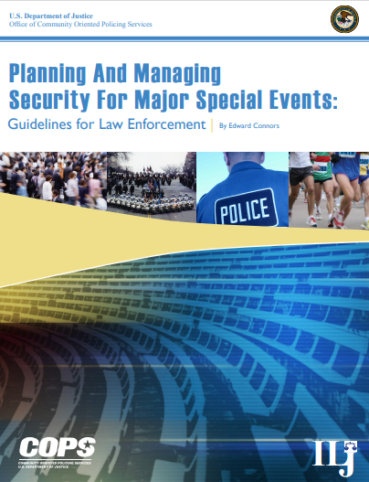
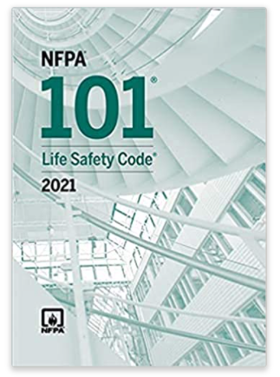
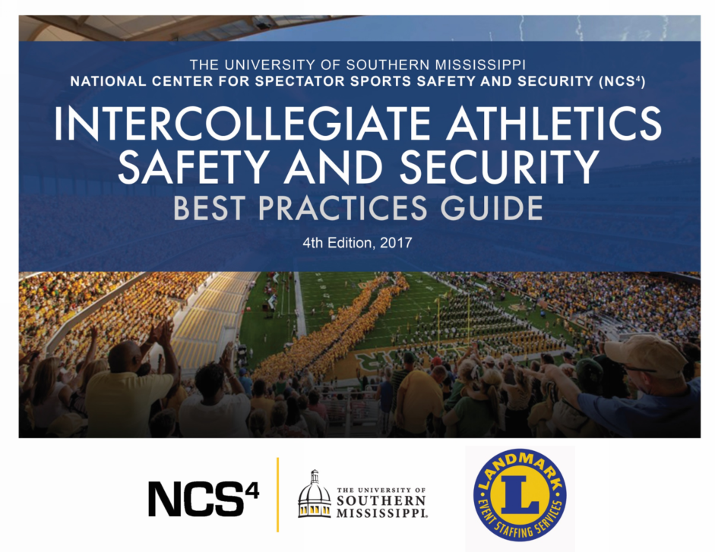
RISK ASSESSMENT
Primary References and Resources

Slide 6
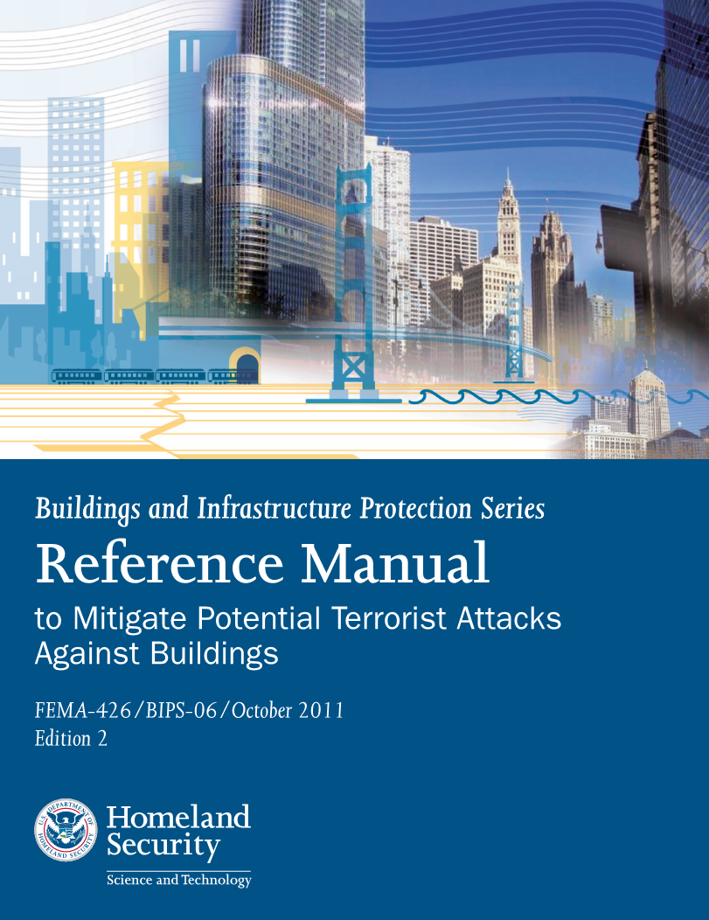
RISK ASSESSMENT
Primary References
Proven methodology
Structured, consistent, data-driven and fact-based approach
Improves resiliency to threats and hazards
Industry Standards and best practices

Slide 7
RISK ASSESSMENT
Primary Resource
Recommends conducting a risk assessment
“Planning for the reasonably foreseeable risks and hazards associated with an event is even more difficult and essential to the event’s success. Before scheduling an event, the organizer should consider the scope of the event, the risks to spectators and participants, community impact, and the emergency support required (personnel and logistics).”
“Effective planning is concerned with hazard identification and the mitigation or elimination of those hazards to reduce or eliminate risks.”

Slide 8
RISK ASSESSMENT
Primary Resource
Recommends conducting a risk assessment
“While planning an event, it is important to consider every possible risk and hazard that may occur. The responsibilities for dealing with these risks vary with each jurisdiction, and every community needs to have a plan listing who or what organization will respond to the anticipated risks or hazards.
Included in this Manual is a detailed 69 page Pre-Event Planning Matrix that may prove helpful to the Task Force (Appendix A)

Slide 9
RISK ASSESSMENT
Primary Resource
Recommends conducting a risk assessment
“Each outdoor venue should conduct its own risk assessment and tailor its plans according to the risk at its facility.”
“Operators of outdoor venues that attract large crowds are responsible for assessing their specific vulnerabilities and practicing the best and most cost-effective mitigation strategies for their own unique security needs.”

Slide 10
RISK ASSESSMENT
Primary Resource
Recommends conducting a risk assessment

Slide 11
RISK ASSESSMENT
Primary Resource
Recommends conducting a risk assessment
“Early in the major special event planning process, law enforcement needs to conduct a comprehensive threat and risk assessment regarding the special event in order to plan for possible situations.
“Assign responsibility for the assessment to an experienced and qualified assessor. In smaller events, this may be a one-person assignment. For major events, the executive team may ask each subcommittee to conduct its own assessment in its area of responsibility.”

Slide 12
RISK ASSESSMENT
Primary Resource
Critically important resource
NFPA 101, Life Safety Code, is the most widely referenced source for occupant safety strategies based on construction, protection, and occupancy features in all stages of a building life cycle. NFPA covers everything from means of egress and features of fire protection to hazardous materials emergencies, injuries from falls, and emergency communications.
The 2021 edition is the resource for getting up to date and compliant with critical life safety requirements.

Slide 13
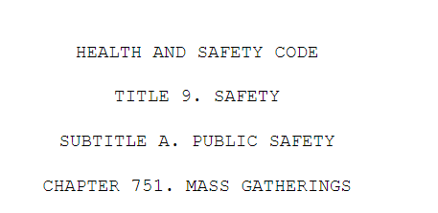
TEXAS MASS GATHERINGS ACT
Primary Statutes
Defines “Mass Gathering(s)”
Identifies Mass Gathering Rules and Regulations
9 page document

Slide 14
RECOMMENDATIONS AND DISCUSSION
Consider making the Risk Assessment part of the Application Procedure for the Texas Mass Gatherings Act (consistent state-wide approach to events)
Consider listing available references and resources for venues to utilize to complete their Risk Assessments and other Plans (to include Appendix A: Pre-Event Planning Matrix from the FEMA Special Events Contingency Planning Manual) as an Appendix to the Texas Mass Gatherings Act
Collect further input from the Task Force to further strengthen the Texas Mass Gatherings Act
Utilize existing Best Practices from the National Center for Spectator Sports Safety and Security (NCS4) Intercollegiate Athletics Safety and Security Best Practices and incorporate into the Task Force on Concert Safety Recommendations
Recommend that every venue accommodating more than 500 persons be required to have a “Certified Crowd Manager” on staff (crowd training provided through the International Fire Chiefs Association (IFCA))
Address “crowd management strategies” as part of the Application Procedure for the Texas Mass Gatherings Act
Collect further input and data from the Task Force on “Festival Seating”
Develop a Texas “Best Practice Guideline Document” for Outdoor Concerts

Slide 15
Thank you
Darrell Utt
940.315.4006
DUtt@ThorntonTomasetti.com
ThorntonTomasetti.com
www.linkedin.com/in/darrell-utt

