Slide 1

Texas Concert Safety Task Force
Crowd Management Resources
The Wheel We Seek Has Already Been Invented
Steven A. Adelman
Adelman Law Group, PLLC

Slide 2
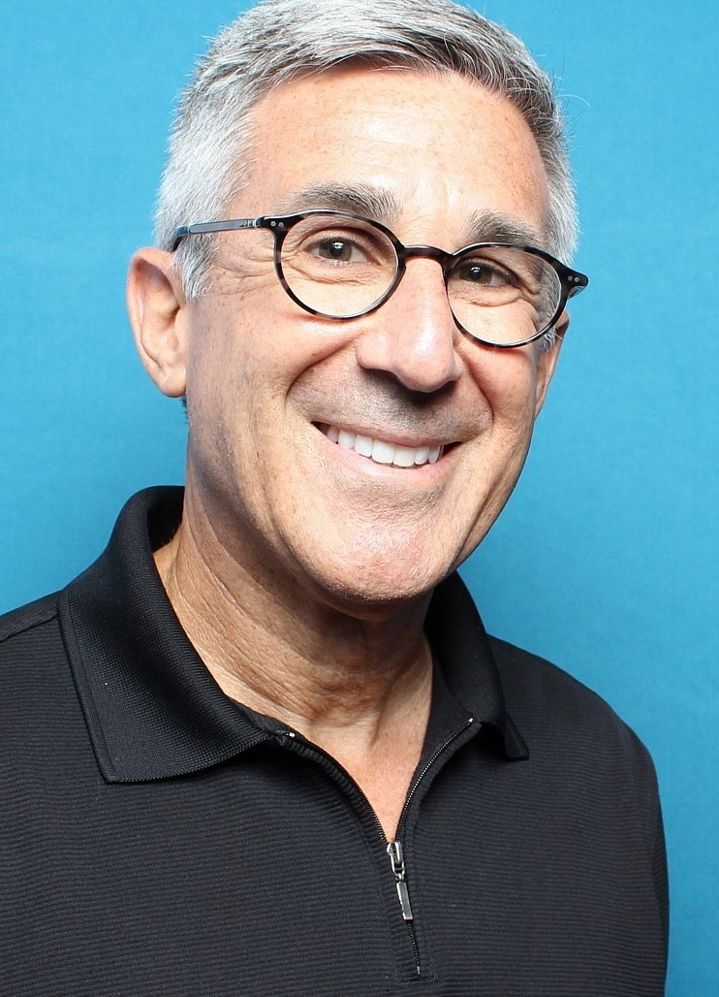


Steve Adelman Credentials
Attorney focused on safety and security at live events
Vice President, Event Safety Alliance
Deputy Chair, Global Crowd Management Alliance
Principal author, ANSI ES1.9-2020, Crowd Management
Contributor to Event Safety Guide
Author of new Crowd Management chapter in NFPA Fire Protection Handbook
Faculty, IAVM Academy for Venue Safety & Security (2007-17)
Adelman Law Group, PLLC

Slide 3
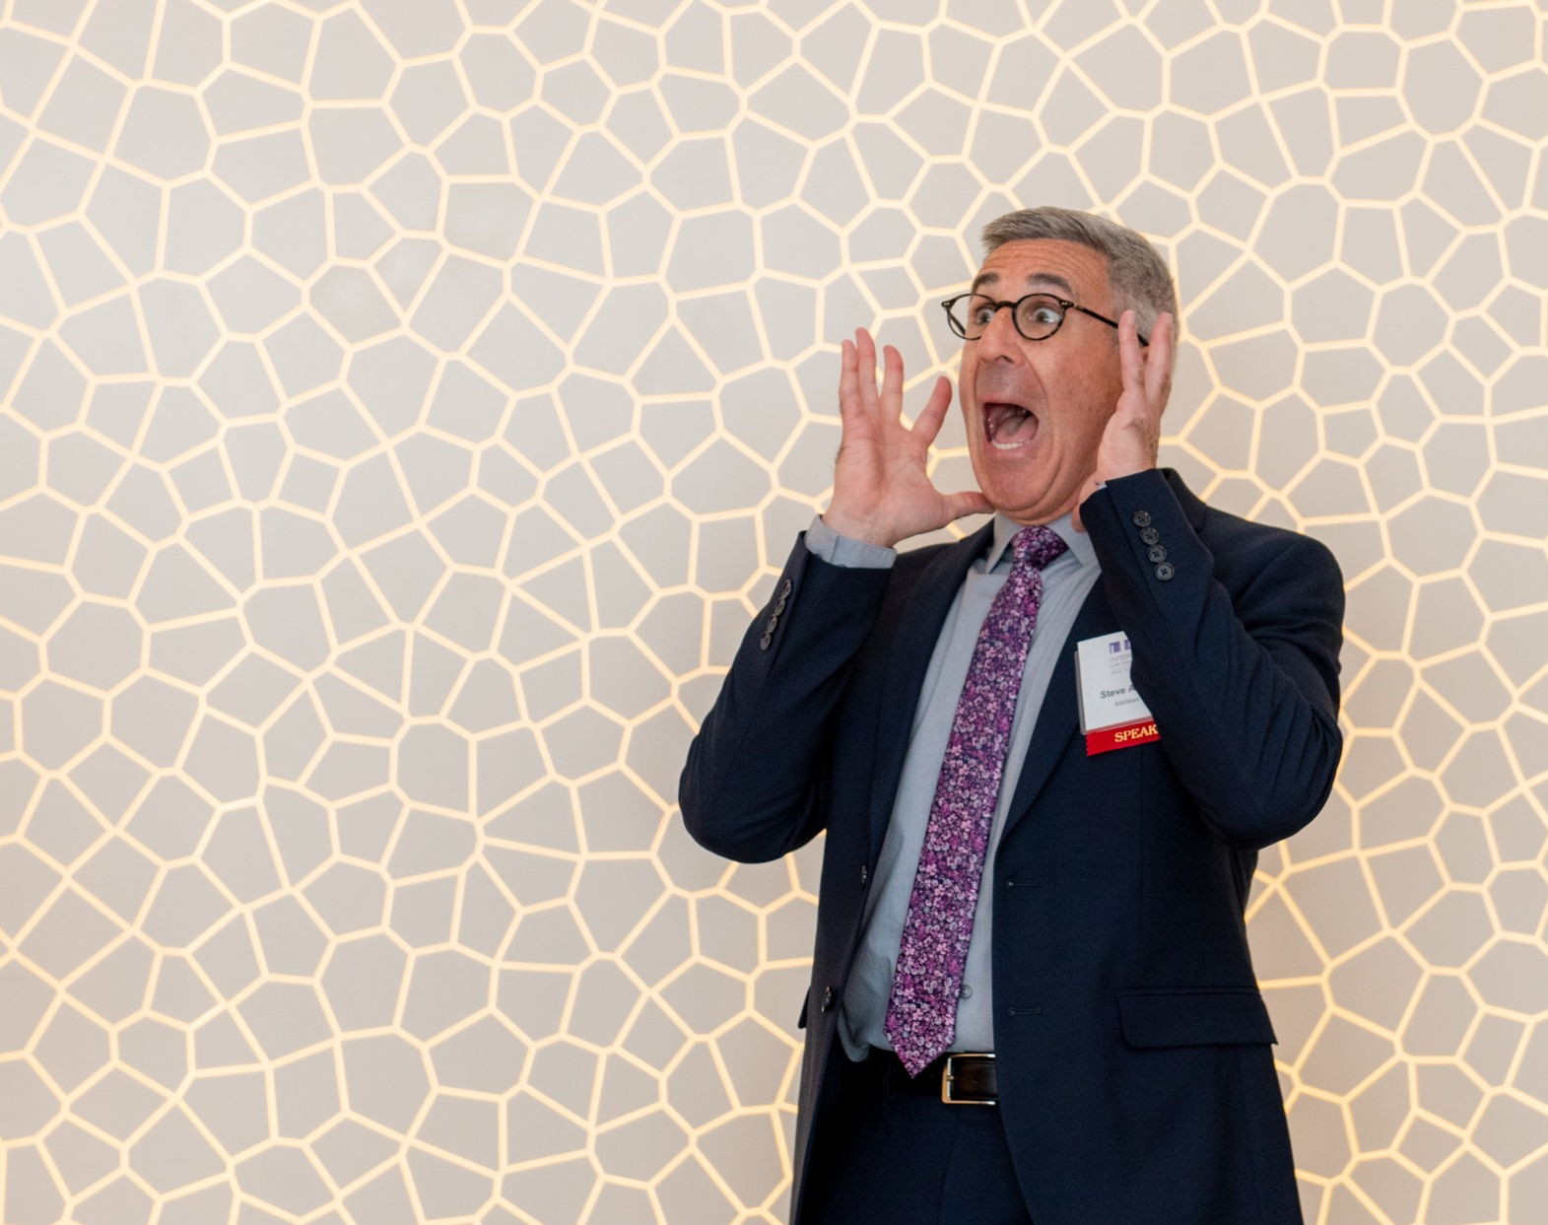
1. Law

Slide 4
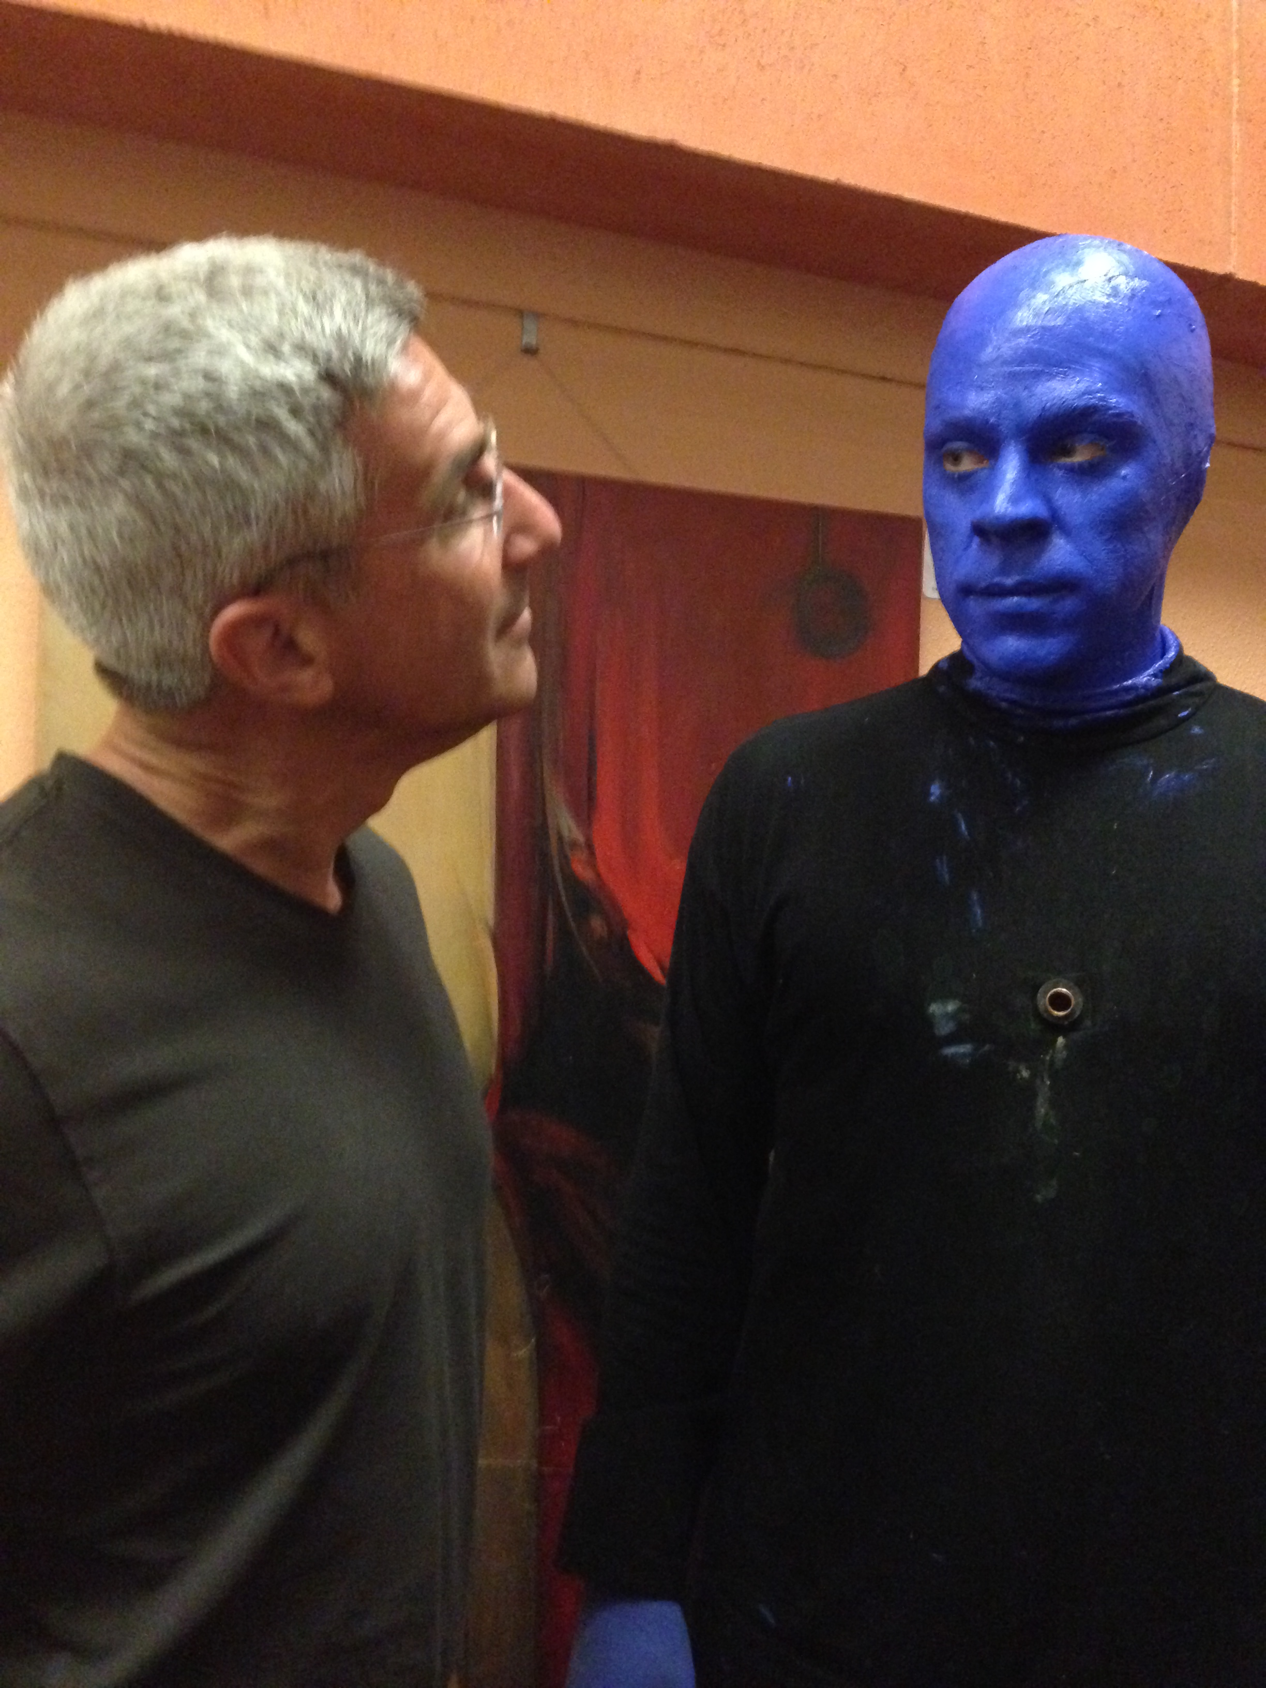
Everyone has a legal duty to behave as a reasonable person under the same or similar circumstances.
Adelman Law Group, PLLC

Slide 5
Consequently, there is no such thing as a “best practice.” There are only practices that may be reasonable under different circumstances.
The goal is to distinguish reasonable practices from unreasonable ones in any given situation.
Adelman Law Group, PLLC

Slide 6
Likewise, although we aspire to an “all hazards” approach to risk, one can plan only for reasonably foreseeable hazards.
A reasonable safety plan need not address every possible scenario. It should be flexible enough to accommodate the inevitable decisions made during any event.
Adelman Law Group, PLLC

Slide 7
2. Risk Mitigation Resources that Already Exist for People Who Plan Events

Slide 8
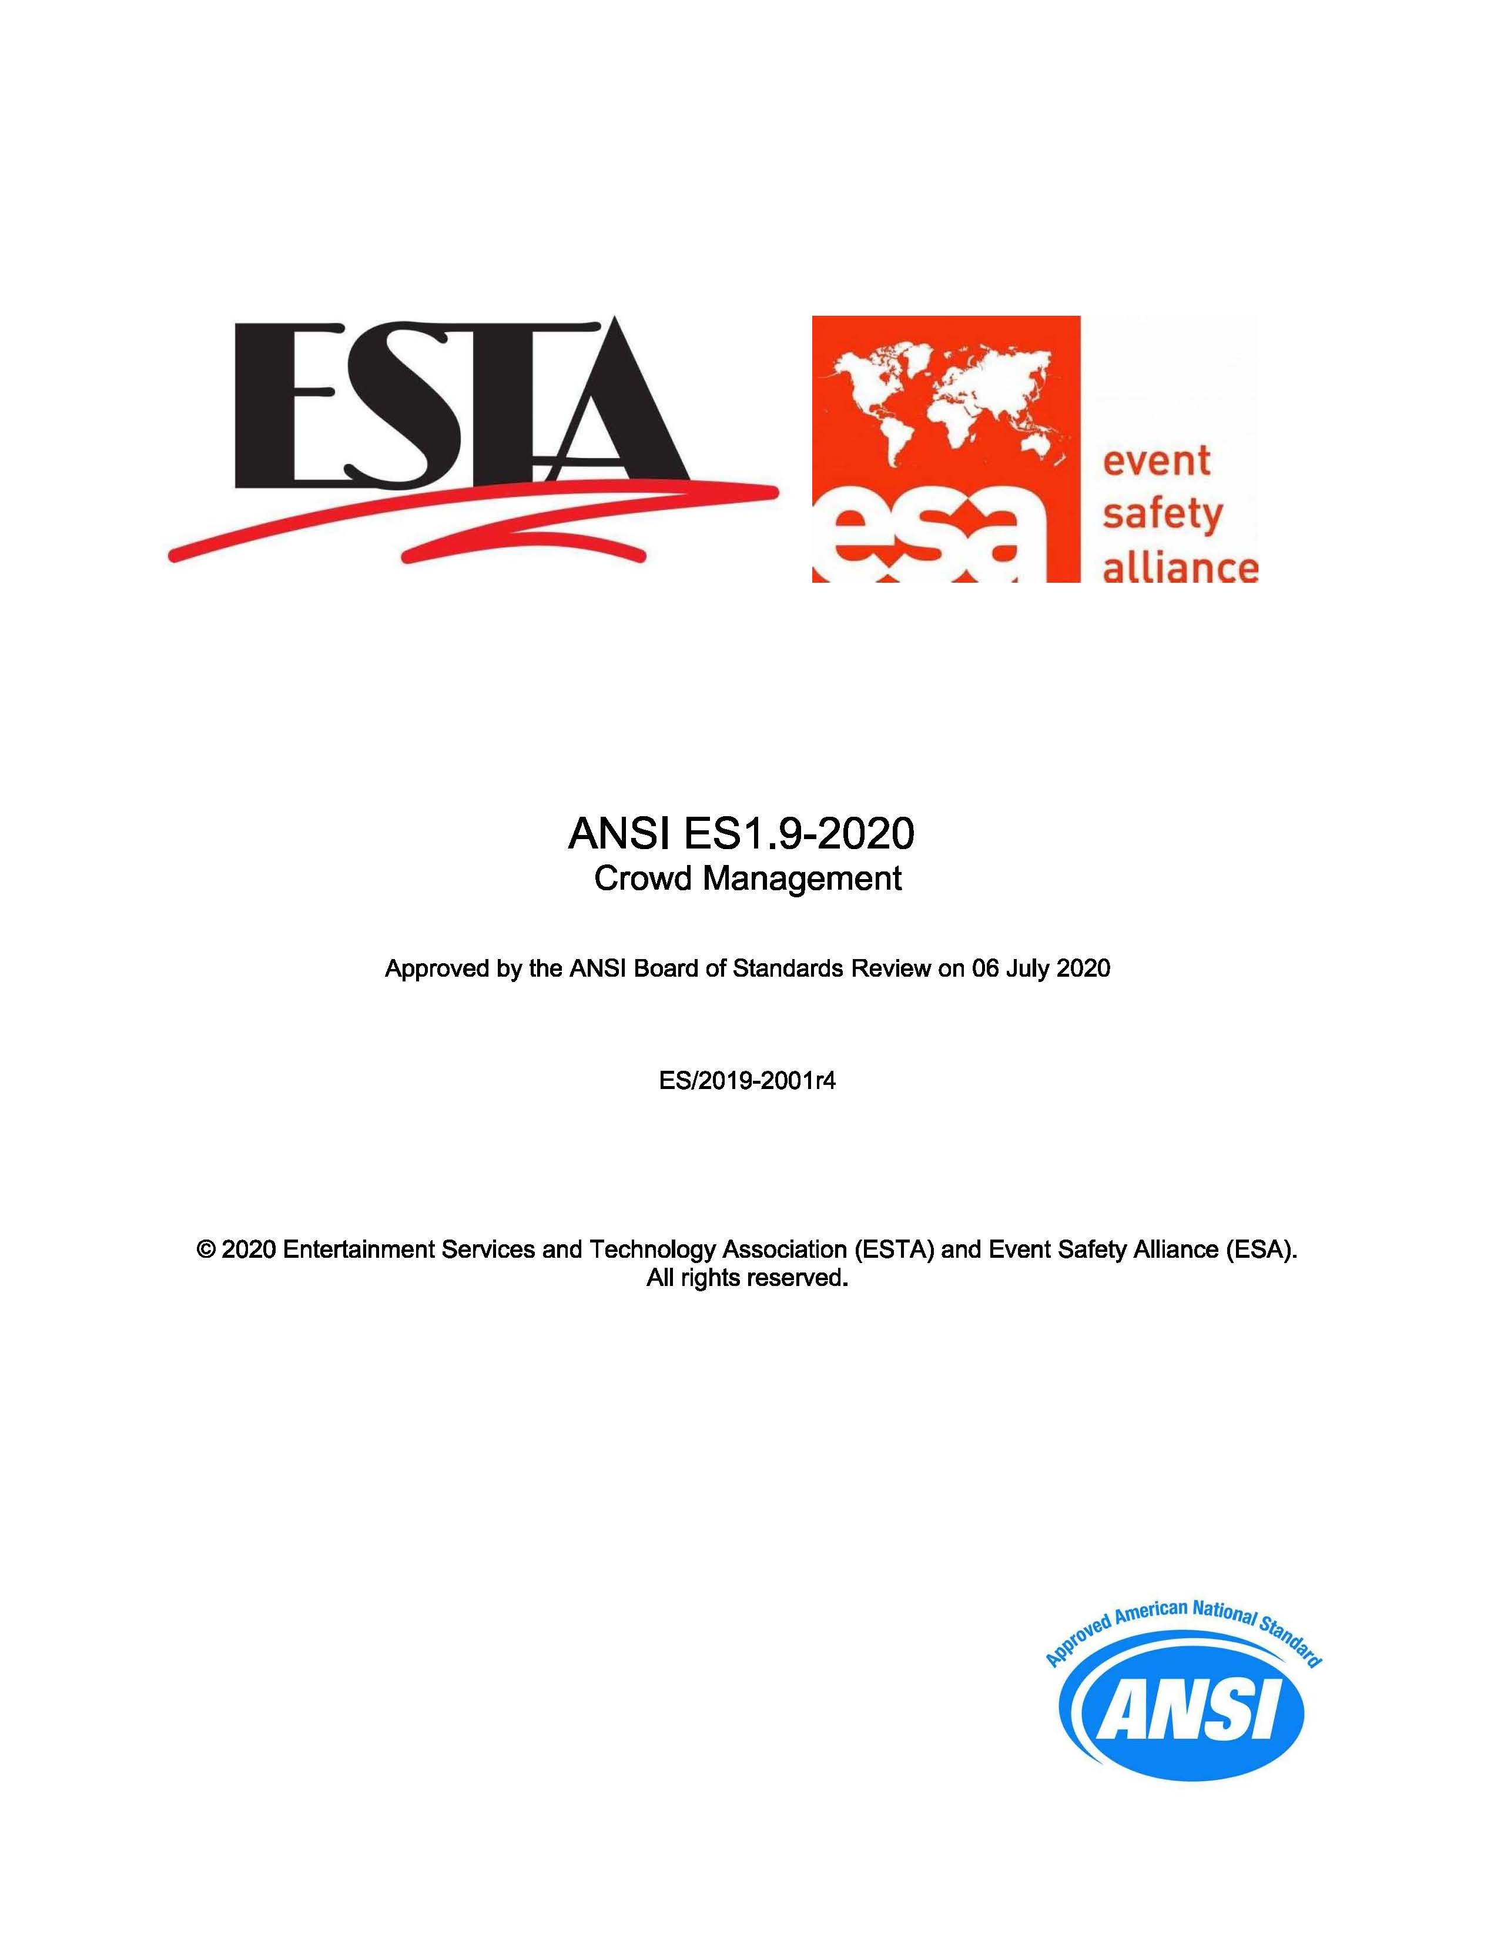
https://tsp.esta.org/tsp/documents/published_docs.php (Free downloads)
Adelman Law Group, PLLC

Slide 9
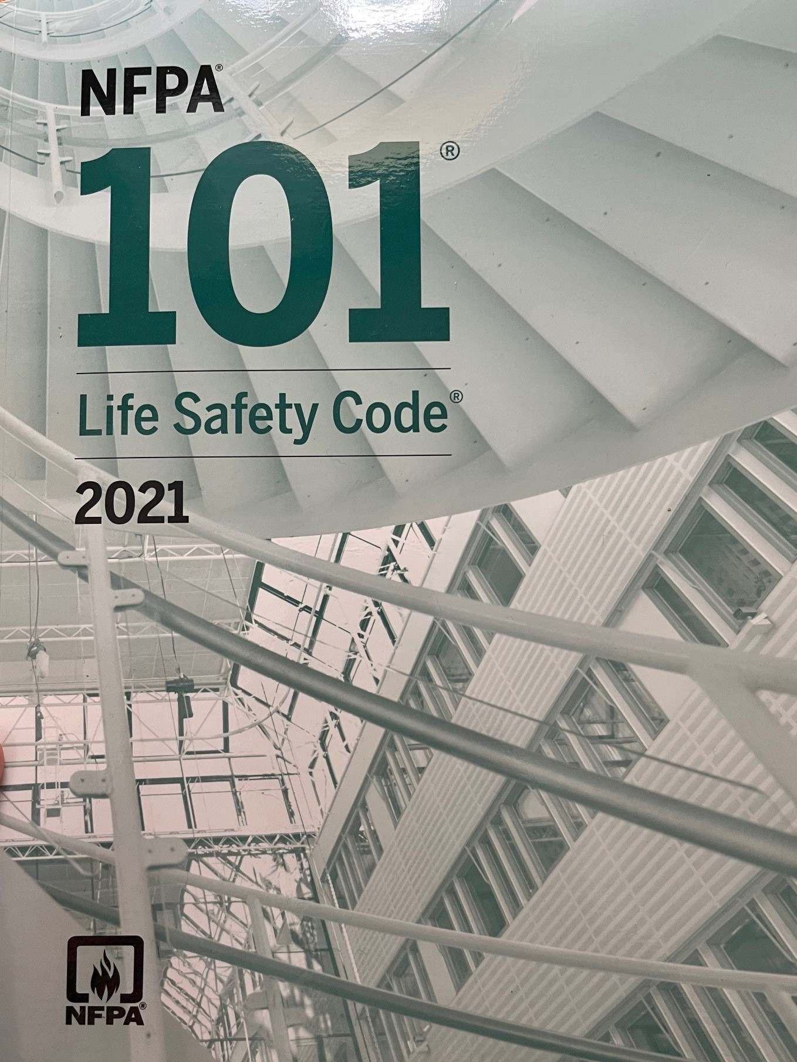
1:250 trained crowd managers
“Festival seating”
Life Safety Plan
https://www.nfpa.org/codes-and-standards/all-codes-and-standards/list-of-codes-and-standards/detail?code=101 ($123.50)
Adelman Law Group, PLLC

Slide 10

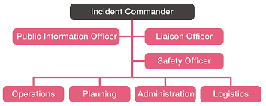
Incident Command System
https://training.fema.gov/is/courseoverview.aspx?code=is-100.c (Free two-hour online course)
Adelman Law Group, PLLC

Slide 11
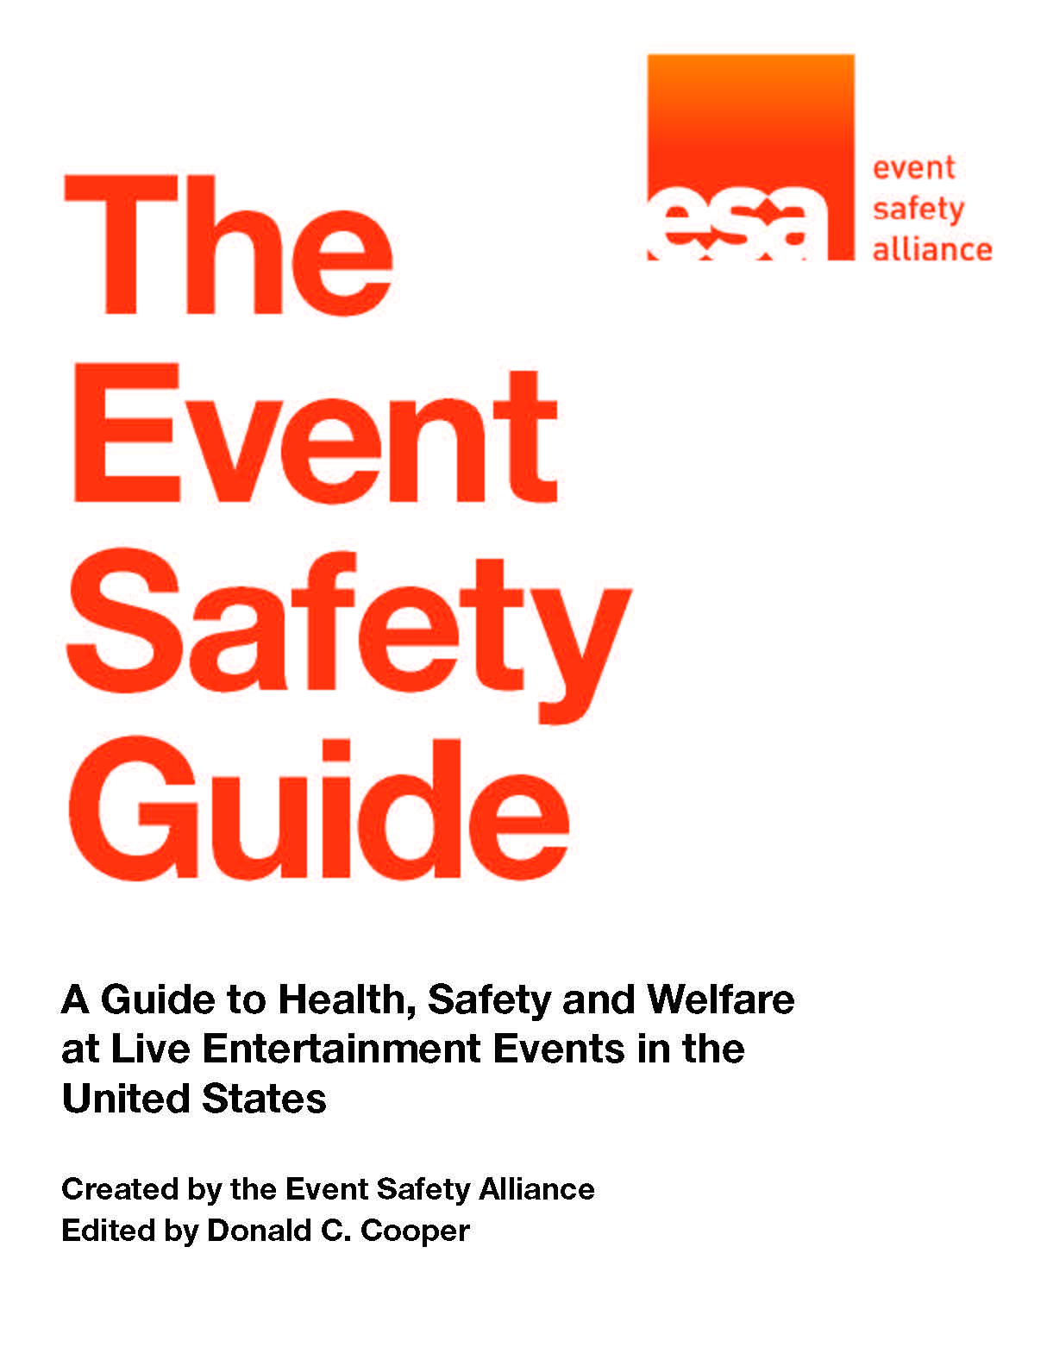
https://www.eventsafetyalliance.org/the-event-safety-guide (Free download)

Slide 12


Online Crowd Manager Training
https://www.trainedcrowdmanager.com/#/home/
https://ncs4.usm.edu/training/crowd-safety-course/
Phase 1 online training: $50
Fundamentals of Crowd Safety: Eight-hour online training: $195
Notes:
Still: Fundamentals of Crowd Safety – 8 hours, led by Keith Still

Slide 13

In-Person Crowd Manager Training
https://www.eventsafetyalliance.org/crowd-safety-symposium-workshops
(Two-day in-person training: $235 for ESA members, $260 for non-members)
Adelman Law Group, PLLC

Slide 14
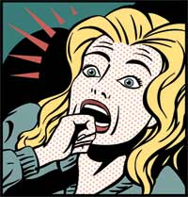
When someone planning an event asks
“What could go wrong?”
these resources can help focus the inquiry.
Adelman Law Group, PLLC

Slide 15
Steve Adelman
Adelman Law Group, PLLC
sadelman@adelmanlawgroup.com
480-209-2426
www.adelmanlawgroup.com
www.eventsafetyalliance.org
www.thegcma.com

